Slide 1
Campus access refresh
Cisco network design | Niyyasoft
Site: Riyadh HQ
Revision: v1
Prepared by: Niyyasoft
Generated: 20 September 2026, 22:33
Cisco Switch Selector Tool -- data sourced from cisco.com data sheets

Slide 2
Solution summary
Scale of the proposed design
2
Models
2
Units
32
Access ports
0
Links
0
Optics / cables
2
Rack units
Campus access refresh

Slide 3
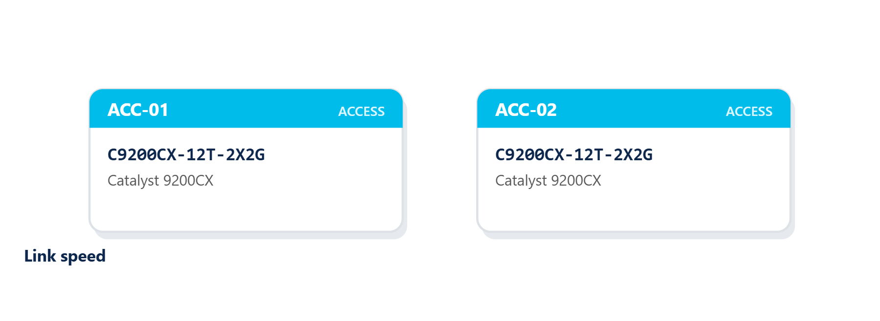
Connectivity diagram
Riyadh HQ
Campus access refresh

Slide 4
Hardware inventory
Page 1 of 1
Name | Model | Role | Location | Qty | Stack | Modules | PoE
ACC-01 | C9200CX-12T-2X2G | access |  | 1 | 1 | - | None
ACC-02 | C9200CX-12T-2X2G | access |  | 1 | 1 | - | None
Campus access refresh

Slide 5
Bill of materials
Page 1 of 1
Part number | Category | Description | Qty
C9200CX-12T-2X2G | Chassis / switch | Catalyst 9200CX -- Fanless compact switch for out-of-wiring-closet deployments. | 2
Confirm part numbers and lifecycle status with Cisco before ordering

