Slide 1
NIYAASOFT · DLP SELECTOR TOOL
Data protection programme
DLP & DSPM sizing and OEM selection
Customer: Niyyasoft
Recommended: Netskope (96% fit)
Niyyasoft · 20 September 2026

Slide 2
Executive summary
The answer first
Netskope
96%
15 / 15
27
Best-fit OEM
Weighted fit
Must-haves met
Requirements scored
5 OEMs were scored against 27 requirements derived from the environment and the priorities set for Niyyasoft. Netskope ranks first with a weighted fit of 96%, meeting 15 of 15 must-have requirements with no gaps. SaaS - Netskope One on NewEdge. Customer-side footprint is 5 VM(s) (2x Netskope Cloud Exchange (Large), 2x Netskope DSPM sidecar (in customer cloud), 1x Netskope DSPM appliance (VMware OVA)); everything else runs in the Netskope tenant.
Niyaasoft | DLPST | Data protection programme
2

Slide 3
OEM ranking
Fewest must-have gaps first, then highest weighted fit
Rank | OEM | Fit | Reading | Must-haves met | Must-have gaps | Delivery model
#1 | Netskope | 96% | Strong fit | 15 / 15 | None | SaaS - Netskope One on NewEdge
#2 | Proofpoint | 94% | Strong fit | 15 / 15 | None | SaaS - Proofpoint Data Security platform
#3 | Forcepoint | 93% | Strong fit | 15 / 15 | None | Hybrid - Forcepoint DLP 10.4 on-premises + Data Security Cloud
#4 | Symantec (Broadcom) | 92% | Strong fit | 15 / 15 | None | On-premises Enforce + detection servers, with cloud detectors
#5 | Fortra (Digital Guardian) | 92% | Strong fit | 15 / 15 | None | SaaS - Fortra DLP (cloud console + ARC) with on-prem gateways a…
Niyaasoft | DLPST | Data protection programme
3

Slide 4
How each OEM matches the requirements
Weighted fit per capability area
Capability area | Netskope | Proofpoint | Forcepoint | Symantec | Fortra
Endpoint | 85% | 100% | 100% | 100% | 100%
Email, web & network | 100% | 92% | 93% | 93% | 92%
Cloud apps, CASB & GenAI | 100% | 100% | 85% | 90% | 90%
Data-at-rest discovery | 93% | 93% | 100% | 100% | 100%
DSPM | 100% | 85% | 85% | 78% | 88%
Detection & classification | 97% | 100% | 99% | 91% | 86%
Protection & insider risk | 89% | 84% | 85% | 86% | 99%
Operations & integration | 100% | 100% | 100% | 100% | 88%
Overall weighted fit | 96% | 94% | 93% | 92% | 92%
Niyaasoft | DLPST | Data protection programme
4

Slide 5
Requirement-by-requirement ratings (1/3)
Native · Add-on product · Partial · Not documented · Not available
Requirement | Priority | Netskope | Proofpoint | Forcepoint | Symantec | Fortra
Windows endpoint agent | Must have | Add-on product | Native | Native | Native | Native
macOS endpoint agent | Must have | Add-on product | Native | Native | Native | Native
Cloud email DLP (Microsoft 365 / Google) | Must have | Native | Native | Native | Native | Native
Web DLP via existing proxy (ICAP) | Nice to have | Native | Add-on product | Native | Native | Add-on product
Secure Web Gateway from the same vendor | Must have | Native | Add-on product | Add-on product | Add-on product | Add-on product
API CASB DLP for sanctioned SaaS | Must have | Native | Native | Add-on product | Add-on product | Add-on product
Inline CASB (shadow IT, instance control) | Must have | Native | Native | Add-on product | Add-on product | Add-on product
GenAI app protection (ChatGPT, Copilot, ...) | Must have | Native | Native | Add-on product | Native | Native
File-share discovery scanning | Must have | Add-on product | Add-on product | Native | Native | Native
SharePoint / collaboration discovery | Must have | Native | Native | Native | Native | Native
DSPM for AWS | Must have | Native | Add-on product | Add-on product | Add-on product | Add-on product
DSPM for Azure | Must have | Native | Add-on product | Add-on product | Add-on product | Add-on product
DSPM for SaaS data (M365, Google, ...) | Should have | Native | Add-on product | Add-on product | Add-on product | Add-on product
Niyaasoft | DLPST | Data protection programme
5

Slide 6
Requirement-by-requirement ratings (2/3)
Native · Add-on product · Partial · Not documented · Not available
Requirement | Priority | Netskope | Proofpoint | Forcepoint | Symantec | Fortra
DSPM for structured data / databases | Should have | Native | Add-on product | Add-on product | Partial | Native
Exact Data Match (EDM) | Must have | Native | Native | Native | Native | Native
Document fingerprinting (IDM) | Must have | Native | Native | Native | Native | Add-on product
OCR / image text detection | Should have | Native | Native | Native | Add-on product | Add-on product
Machine-learning classifiers | Should have | Native | Native | Native | Native | Add-on product
AI / LLM-based classification | Nice to have | Partial | Native | Add-on product | Not available | Not documented
User risk scoring / risk-adaptive policy | Should have | Add-on product | Native | Add-on product | Native | Native
Insider-threat activity / screen capture | Nice to have | Not documented | Add-on product | Not documented | Not available | Native
User-driven classification & labelling | Should have | Native | Partial | Native | Native | Native
Microsoft Purview (MIP) label integration | Should have | Native | Native | Native | Native | Native
Encryption / DRM on block or quarantine | Nice to have | Native | Add-on product | Partial | Partial | Add-on product
Incident workflow & remediation | Must have | Native | Native | Native | Native | Native
SIEM / SOAR integration | Must have | Native | Native | Native | Native | Native
Niyaasoft | DLPST | Data protection programme
6

Slide 7
Requirement-by-requirement ratings (3/3)
Native · Add-on product · Partial · Not documented · Not available
Requirement | Priority | Netskope | Proofpoint | Forcepoint | Symantec | Fortra
REST API | Should have | Native | Native | Native | Native | Partial
Niyaasoft | DLPST | Data protection programme
7

Slide 8
Netskope
96% weighted fit · Strong fit · must-haves 15/15
Strengths for this brief
Cloud email DLP (Microsoft 365 / Google)
Secure Web Gateway from the same vendor
API CASB DLP for sanctioned SaaS
Inline CASB (shadow IT, instance control)
GenAI app protection (ChatGPT, Copilot, ...)
SharePoint / collaboration discovery
DSPM for AWS
DSPM for Azure
DSPM for SaaS data (M365, Google, ...)
Gaps and risks
Nothing flagged.
Niyaasoft | DLPST | Data protection programme
8

Slide 9
Workload to size for
End-of-term figures shared by every OEM
Step | Value | How
Growth factor | 1.331x | (1 + 10%) ^ 3 years - every count below is the end-of-term figure
Users | 6,656 | 5,000 today x growth
Endpoint agents | 6,390 | 5,990 Windows + 400 macOS + 0 Linux + 0 VDI sessions
Email - messages/day | 266,240 | 6,656 users x 40 messages
Email - busy hour | 39,936 msg/h | 15% of the daily volume in the busiest hour (planning assumption)
Web egress to inspect | 1.3 Gbps | 1 Gbps today across 1 egress point(s) x growth
Data at rest to scan | 33 TB | 20 TB file shares + 5 TB SharePoint today x growth
Required scan rate | 95 GB/h | full pass in 30 days x 12 scanning hours/day = 360 hours
Cloud accounts in DSPM scope | 8 | 5 AWS accounts + 3 Azure subscriptions + 0 GCP projects
Data under posture management | 200 TB | 133 TB IaaS/PaaS + 67 TB SaaS, x growth
Incidents per day | 333 | estimated at 0.05 per user per day for a tuned policy set (planning assumption - replace with…
Incident storage | 29 GB | 333/day x 365 days retention x 250 KB average incident (planning assumption)
Niyaasoft | DLPST | Data protection programme
9

Slide 10
Netskope bill of materials
SaaS - Netskope One on NewEdge · 5 server(s), 48 vCPU, 128 GB RAM to host
Component | Where | Qty | Specification per unit | Sizing basis
Netskope One tenant (NewEdge) - Next Gen SWG + inline DLP, API data p… | OEM cloud | 1 | SaaS - 120+ data centres in 80+ regions; management planes… | Single console for every channel; no customer hardware
Netskope Client - Traffic steering to NewEdge + Endpoint DLP (Windows… | Users, endpoints & branches | 6,390 | Typical 0-5% CPU, 100-150 MB RAM, ~150 MB disk | One per endpoint and VDI session; Endpoint DLP is an add-on on Windows and macOS
IPsec tunnels to NewEdge - Site steering for agentless devices and se… | Perimeter / DMZ | 2 | 2 Gbps tier per tunnel, IKEv2 | 1.3 Gbps per egress point; tunnels to at least 2 POPs per egress point (1 egress point(s)).
Netskope Cloud Exchange (Large) - SIEM log shipping + EDM hashing | Customer data centre | 2 | 16 cores / 32 GB RAM / 120 GB disk | 6,656 users x 0.75 events/min = 5K events/min; EDM module needs the Large profile (16 cores / 32 GB). Second…
Netskope DSPM sidecar (in customer cloud) - Agentless scanning of dat… | Customer cloud (IaaS/PaaS) | 2 | 4 vCPU / 16 GB / 100 GB (AWS m5.xlarge) | 267 data stores over 30 days at 50 stores/day per sidecar (low end of 50-100) = 1; at least one per cloud (2)…
Netskope DSPM appliance (VMware OVA) - On-prem file share (CIFS/NFS)… | Customer data centre | 1 | 8 cores / 32 GB RAM / 100 GB disk | 95 GB/h to scan; Netskope publishes no files/hour figure, so 100 GB/h per appliance is a planning assumption.…
Niyaasoft | DLPST | Data protection programme
10

Slide 11
Licensing lines
What the design implies - not a quotation
Product / module | Metric | Quantity | Note
Netskope One Next Gen SWG | Users | 6,656 | Inline web DLP
Netskope One CASB (inline + API) | Users | 6,656 | 1 sanctioned app(s)
Netskope One DLP (advanced) | Users | 6,656 | EDM, fingerprinting, OCR, ML across channels
Netskope Endpoint DLP (add-on) | Users | 6,656 | Windows and macOS
Advanced UEBA | Users | 6,656 | UCI-based adaptive policies
Netskope One DSPM | Per Netskope quote | Scope: 200 TB | 8 cloud account(s)
Niyaasoft | DLPST | Data protection programme
11

Slide 12
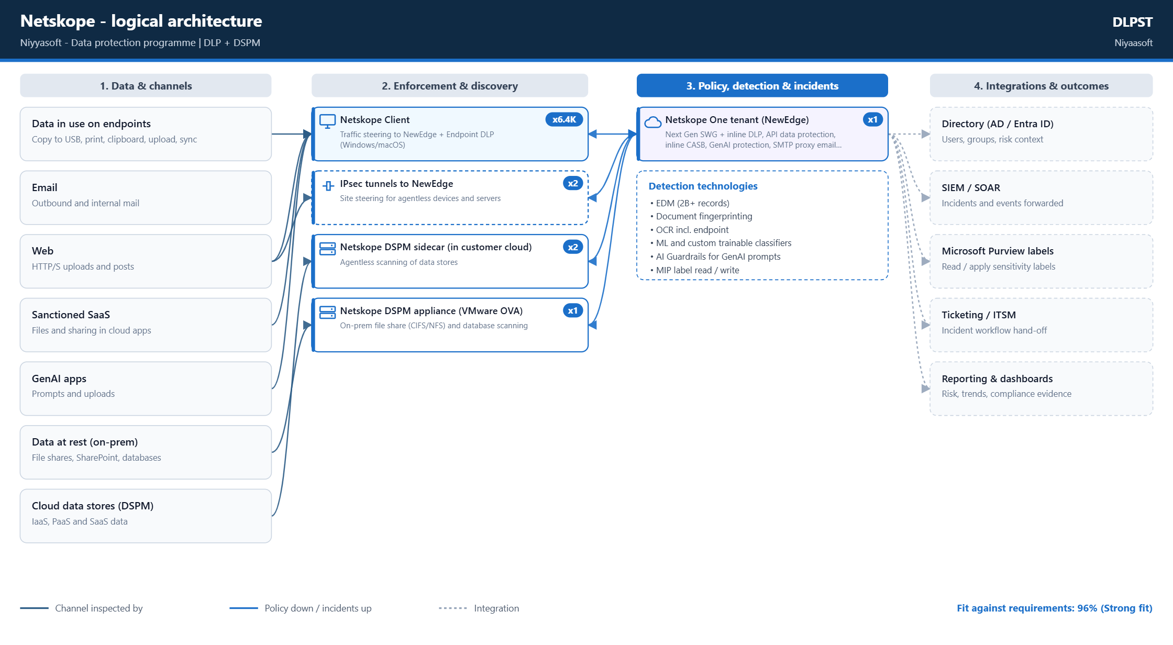
Logical architecture
Netskope
Niyaasoft | DLPST | Data protection programme
12

Slide 13
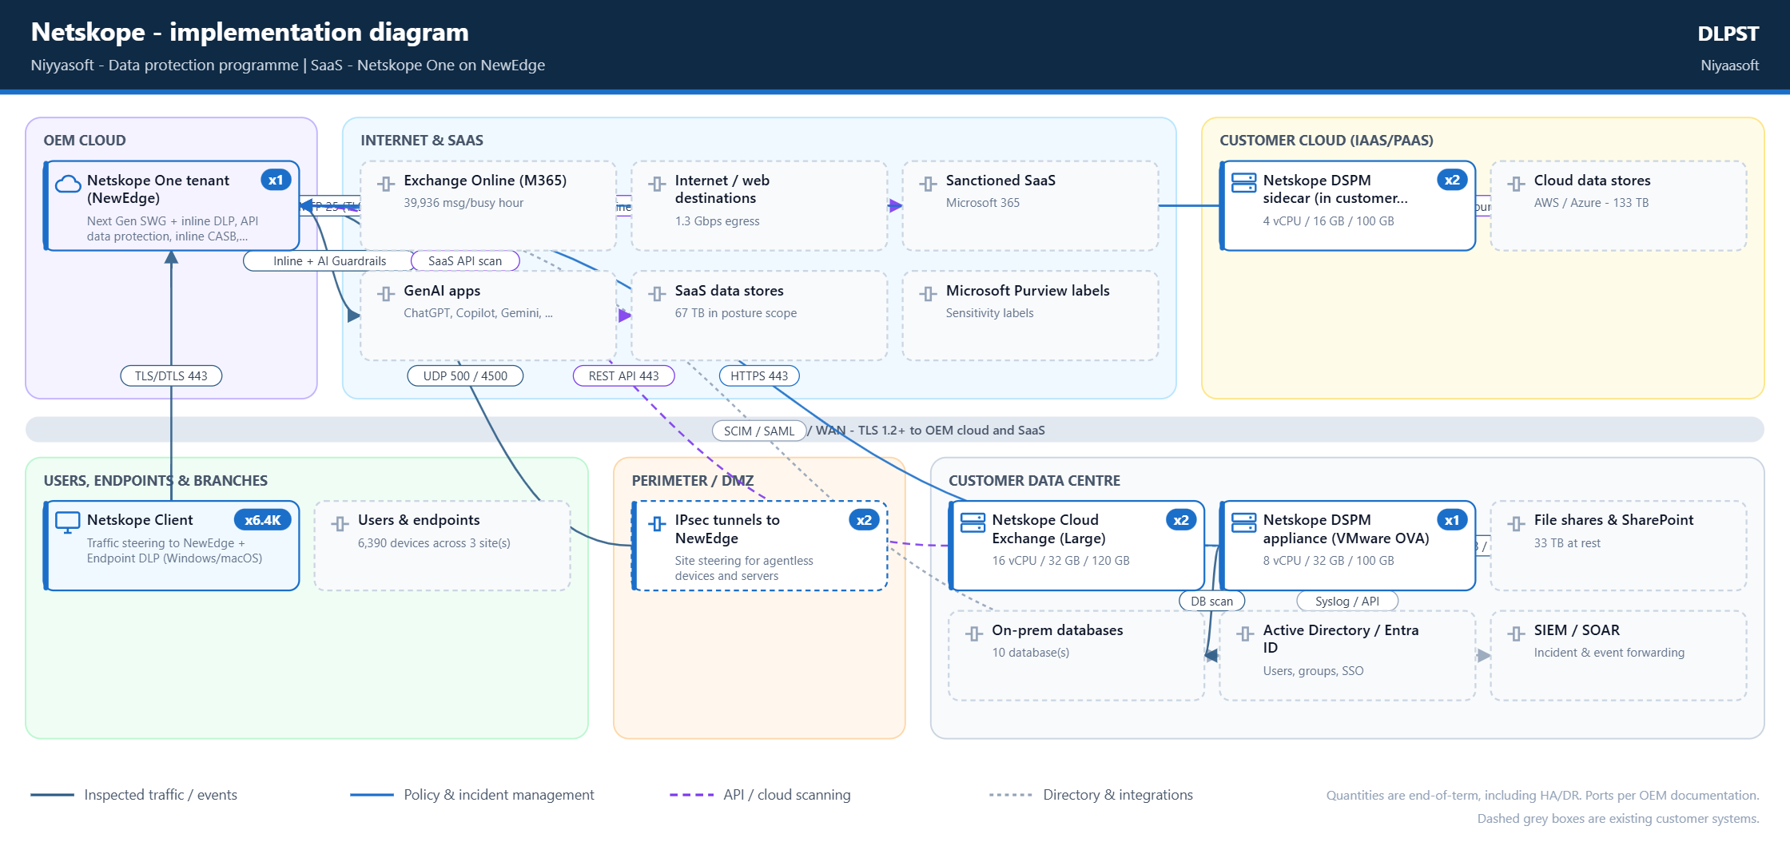
Implementation diagram
Netskope
Niyaasoft | DLPST | Data protection programme
13

Slide 14
Rollout plan
Netskope best-practice phases
Phase | Activities
1. Steering foundation | Allowlist client/tunnel destinations; choose steering (Client, IPsec/GRE to 2 POPs, explicit proxy); deploy test steering config to early adopters; review exceptions and…
2. DLP content definition | Create entities/dictionaries, rules, DLP profiles and file profiles; import EDM hashes / fingerprints.
3. Monitor (alert-only) | Apply policies in alert mode across web/SaaS/email/endpoint; review incidents and forensics to find false positives.
4. Coach | Enable user-alert/coaching on sensitive transfers (esp. Endpoint DLP) before blocking.
5. Enforce and optimize | Switch tuned policies to block/quarantine; restrict high-risk groups; continuously refine using DLP reports.
DSPM onboarding | Onboard cloud accounts (org-level onboarding auto-detects child accounts/data stores); deploy sidecars (one per VPC/VNet) and DLP appliance/Single Appliance; set scan fr…
Niyaasoft | DLPST | Data protection programme
14

Slide 15
Assumptions and next steps
OEM capabilities, capacities, hardware requirements and ports are taken from the official vendor websites and documentation linked in this document. They change with product releases - confirm against the current documentation be…
All workload figures are end-of-term values: 10% annual growth compounded over 3 years (factor 1.33).
Mail busy hour is taken as 15% of daily volume (planning assumption).
Incident volume is estimated at 0.05 incidents per user per day for a tuned policy set; untuned monitor-mode policies can generate several times more. Replace with a measured figure after the monitoring phase.
Incident storage assumes 250 KB per stored incident including matched content and metadata (planning assumption).
Detection servers are sized to run at no more than 75% of the OEM published maximum at the end of the term; HA adds an N+1 unit and a DR site adds a standby set.
Next steps
Validate the must-have list with data owners and compliance
Shortlist the top two OEMs for a proof of value on real data
Confirm sizing and licences with the OEM or partner
Start in monitor-only mode; move to blocking after tuning
Niyaasoft | DLPST | Data protection programme
15

