Slide 1
Migration Tool Selector (MTS) - Niyya Software
VMware exit - wave 1
V2V - Virtual to Virtual: VMware vSphere / ESXi (vCenter) to Nutanix AHV (Prism)
Niyyasoft | Prepared by Niyyasoft | 20 September 2026
Vendor and licensing data last reviewed 2026-09-18. Indicative only - confirm with the OEM.

Slide 2
Executive summary
V2V - Virtual to Virtual: VMware vSphere / ESXi (vCenter) to Nutanix AHV (Prism)
Why this tool: Supports V2V as a first-class scenario.
Why this tool: Explicitly supports VMware vSphere / ESXi (vCenter) as a source and Nutanix AHV (Prism) as a target.
Why this tool: Wave and batch orchestration, which matters at 180 workloads.
Why this tool: Agentless, so there is no per-server software deployment to get approved.
Watch out for: Does not provide live migration (no guest downtime).
Watch out for: Does not provide rollback / failback after cutover.
Watch out for: Does not provide application dependency mapping.

Slide 3
At a glance
Measure | Value
Scenario | V2V - Virtual to Virtual: VMware vSphere / ESXi (vCenter) to Nutanix AHV (Prism)
Recommended tool | Commvault Cloud (Complete Backup & Recovery)
OEM / vendor | Commvault
Cost posture | Paid - Per-TB front-end or per-VM subscription
Cutover profile | Warm - seeded online, short cutover window
Workloads in scope | 180
Data to move | 46.0 TB
Link between source and target | 1,000 Mbps
Raw transfer time at 65% efficiency | 6.9 days

Slide 4
Recommended: Commvault Cloud (Complete Backup & Recovery)
Commvault - Paid - Per-TB front-end or per-VM subscription
Why: Genuine any-to-any conversion on restore across a very wide platform matrix, including UNIX, and strong reporting for audit-heavy programmes.
Limits: Complex to set up if you do not already run it; licensing needs careful sizing.
Licence model: Subscription by front-end terabyte or per-VM/per-instance, depending on the package.
How to license: Quote through Commvault or a partner; also on AWS/Azure marketplaces for cloud-spend drawdown.
Cutover profile: Warm - seeded online, short cutover window

Slide 5
Shortlist
Ranked against the constraints entered
Tool | OEM / vendor | Cost | Licensing model | Fit
Commvault Cloud (Complete Backup & Recovery) | Commvault | Paid | Per-TB front-end or per-VM subscription | 150
Veeam Data Platform (Backup & Replication) | Veeam Software | Paid | Veeam Universal Licence (VUL), typically sold in 10-instance packs | 150
Nutanix Move | Nutanix | Included | No charge to Nutanix customers | 138
NAKIVO Backup & Replication | NAKIVO | Paid | Per-socket or per-workload perpetual/subscription; free trial and a free edition for small use | 134
Cohesity DataProtect (incl. Veritas NetBackup) | Cohesity | Paid | Per-TB or per-workload subscription | 126
Rubrik Security Cloud | Rubrik | Paid | Per-TB subscription | 122

Slide 6
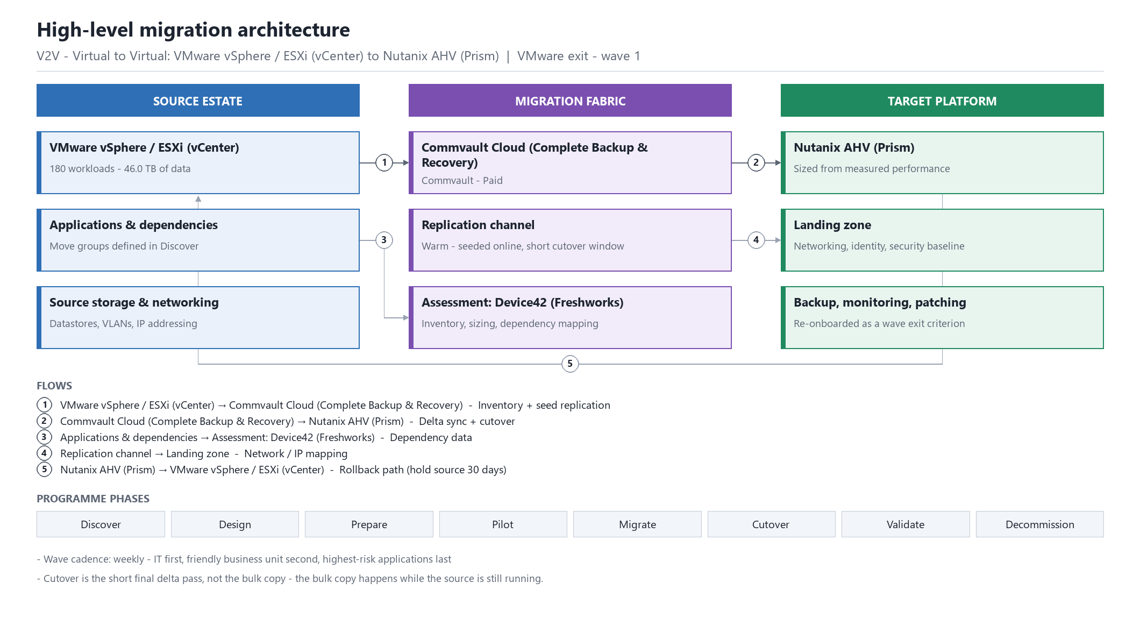
High-level architecture
V2V - Virtual to Virtual: VMware vSphere / ESXi (vCenter) to Nutanix AHV (Prism) | VMware exit - wave 1

Slide 7
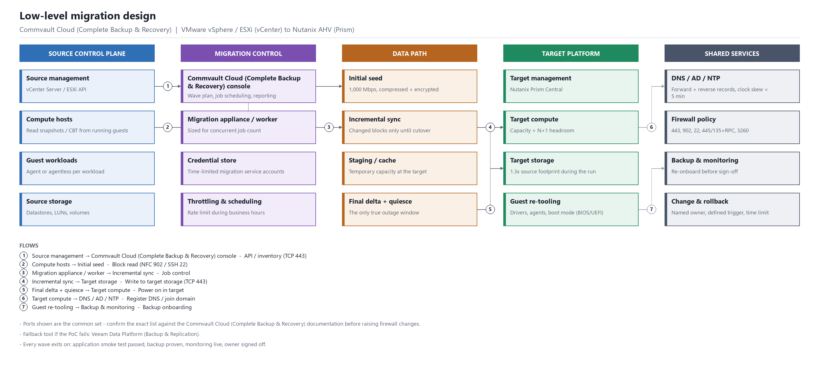
Low-level design
Commvault Cloud (Complete Backup & Recovery) | VMware vSphere / ESXi (vCenter) to Nutanix AHV (Prism)

Slide 8
Migration phases
Full activity list is in the Word and Excel exports
Phase | Objective
Discover | Inventory the estate, profile performance, map application dependencies and agree the scope.
Design | Size and build the target platform, design networking and storage, pick the tool and prove it in a PoC.
Prepare | Deploy migration infrastructure, open firewall paths, stage agents, build move groups and waves.
Pilot | Migrate a low-risk wave end to end, measure throughput, validate the runbook and fix what broke.
Migrate | Run production waves on the agreed cadence with seeded replication and short cutover windows.
Cutover | Final delta sync, stop the source, repoint DNS/load balancers, power on in the target, smoke test.
Validate | Application and business sign-off, performance comparison, backup and monitoring re-onboarding.
Decommission | Hold the source in a recoverable state for the agreed period, then reclaim licences and hardware.

Slide 9
Sizing and wave plan
Measure | Value
Workloads in scope | 180
Data to move | 46.0 TB
Link between source and target | 1,000 Mbps
Raw transfer time at 65% efficiency | 6.9 days
Realistic elapsed time | 11 days allowing for delta passes, retries and contention
Wave plan | 9 waves of about 20

Slide 10
Prerequisites
Everything below must be true before wave one
Prerequisite | Detail
Management access | Administrative credentials on the source platform (VMware vSphere / ESXi (vCenter)) and the target (Nutanix AHV (Prism)).
Migration network | Routed path from the migration appliance/agents to both platforms, with the replication ports open and no deep packet inspection in the way.
Common ports | TCP 443 (platform APIs and most replication), TCP 902 (ESXi NFC), TCP 22 (Linux/appliance), TCP 445/135 + dynamic RPC (Windows agent push), TCP 1500-1520 (replication varies by product).
Name resolution and time | Forward and reverse DNS for every host involved, and NTP consistency - clock skew breaks certificate and Kerberos-based agents.
Staging capacity | Free capacity on the target for the full wave plus snapshots, typically 1.3x the source footprint during the run.
Guest preparation | Local admin/root on each guest, a current backup taken immediately before cutover, and target platform drivers staged.
Change control | Approved change windows per wave and a named rollback owner.

Slide 11
Top risks
Full register is in the Word and Excel exports
Risk | Impact | Mitigation
Guest drivers or boot configuration break on the target platform | High | Stage target drivers (VirtIO, Hyper-V IC, cloud agents) before cutover and test one guest per OS family in the pilot.
Software licensing changes on the new platform | High | Review Oracle, SQL Server, SAP and Windows Server licence terms against the target core/socket model before committing - this can dwarf the migration cost.
IP re-addressing breaks hardcoded dependencies | Medium | Prefer L2 extension or identical subnets; where re-addressing is unavoidable, scan configuration files and firewall rules for literal IPs first.
Backup and monitoring coverage lapses after cutover | Medium | Make backup onboarding and a proven restore part of the wave exit criteria.
Discovery is incomplete and workloads appear late | High | Reconcile at least two independent inventory sources and freeze scope with a dated baseline.
Bandwidth is shared with production and throughput collapses | High | Measure real throughput in the pilot, rate-limit replication during business hours, and re-plan waves on actual numbers.
No agreed rollback trigger, so a bad cutover drags on | High | Define the rollback decision point, the owner and the time limit for every wave before it starts.

Slide 12
Next steps
Confirm commercial terms and short-term migration licensing with Commvault.
Run discovery and dependency mapping, and freeze the scope against a dated baseline.
Stand up the tooling and prove it in a proof of concept on one workload per application family.
Run the pilot wave, measure real throughput, and re-plan the wave schedule on those numbers.
Agree the rollback trigger, the decision owner and the exit criteria for every wave before wave one.

