Slide 1
NUTANIX SIZER ULTRA
Cluster Sizing & Design
Contoso Datacentre Modernisation
Contoso Ltd | Solution Architect | 2026-09-20
22 x Nutanix NX-8170-G9 | RF2, N+1 | NCI Pro

Slide 2
Executive summary
Contoso Datacentre Modernisation - sized 2026-09-20
22
1408
22,528 GB
74.3 TiB
Nodes
Physical cores
Cluster memory
Effective capacity
The proposed design is a 22-node Nutanix cluster built on Nutanix NX-8170-G9, sized for 834 virtual machines, 3,248 vCPU, 12,487 GB of RAM and 103.1 TiB of workload data.
Each node is configured with 2 x 32-core processors, 1024 GB of memory and 11.52 TB of raw storage, giving a cluster total of 1,408 physical cores, 22,528 GB of memory and 230.5 TiB raw.
The cluster is sized N+1 with Redundancy Factor 2. After replication, failure reserve and the 75% utilisation ceiling, 74.3 TiB of effective capacity is available for workload data.
The binding constraint on node count is cpu: 22 nodes would be required for CPU, 18 for memory and 22 for storage.
NCI Pro is the recommended licence edition, covering all 1,408 physical cores in the cluster for a 36-month term.

Slide 3
Workload requirements
834 VMs | 3,248 vCPU | 12,487 GB RAM | 103.1 TiB data
Workload | Use case | VMs | vCPU:core | Total vCPU | Physical cores | Total RAM (GB) | Data (TiB)
Windows general server | Server Virtualisation | 180 | 4:1 | 1,012 | 253 | 4,046 | 38.3
Linux general server | Server Virtualisation | 120 | 4:1 | 337 | 84 | 1,349 | 10.9
VDI - knowledge workers | VDI / End-User Computing | 500 | 6:1 | 1,405 | 234 | 4,215 | 28.8
SQL Server OLTP | Databases & Business Critical Apps | 10 | 2:1 | 225 | 112 | 1,798 | 19.2
Kubernetes workers | Private Cloud / Mixed Workload | 24 | 4:1 | 270 | 67 | 1,079 | 5.9
TOTAL |  | 834 | 4.3:1 | 3,248 | 751 | 12,487 | 103.1

Slide 4
Resource demand by workload

Slide 5
Why this node count
Binding constraint: CPU
Driver | Nodes required | Calculation
CPU | 22 | ceil(1,002 cores required / 48.0 usable cores per node) + 1 spare
Memory | 18 | ceil(15,609 GB required / 952 GB usable per node) + 1 spare
Storage | 22 | ceil(148.4 TiB after RF / (9.4 TiB x 75%)) + 1 spare
Platform minimum | 3 | RF2 minimum cluster size
SELECTED | 22 | Highest of the above (CPU bound)

Slide 6
Cluster resource balance
Metric | Required | Available | Utilisation
Physical cores | 1,002 | 1,008 | 75%
Memory (GB) | 15,609 | 19,992 | 62%
Usable storage (TiB) | 148.4 | 198.0 | 75%
Estimated IOPS | 150,327 | 3,150,000 | 5%

Slide 7
Storage capacity model
103.1 TiB of data becomes 148.4 TiB after efficiency, snapshots and RF2
Metric | Value
Workload data (post growth) | 103.1 TiB
Provisioned capacity | 160.0 TiB
Combined data efficiency assumed | 1.6 : 1
After data efficiency | 62.8 TiB
Snapshot / clone reserve | 11.4 TiB
Usable capacity required | 74.2 TiB
Capacity after RF2 | 148.4 TiB
Per-node raw | 10.5 TiB (11.52 TB)
Per-node usable after AOS overhead | 9.4 TiB
Cluster raw | 230.5 TiB
Cluster usable | 207.5 TiB
Cluster usable after N+1 | 198.0 TiB
Effective workload capacity at the ceiling | 74.3 TiB
Projected storage utilisation | 75%

Slide 8
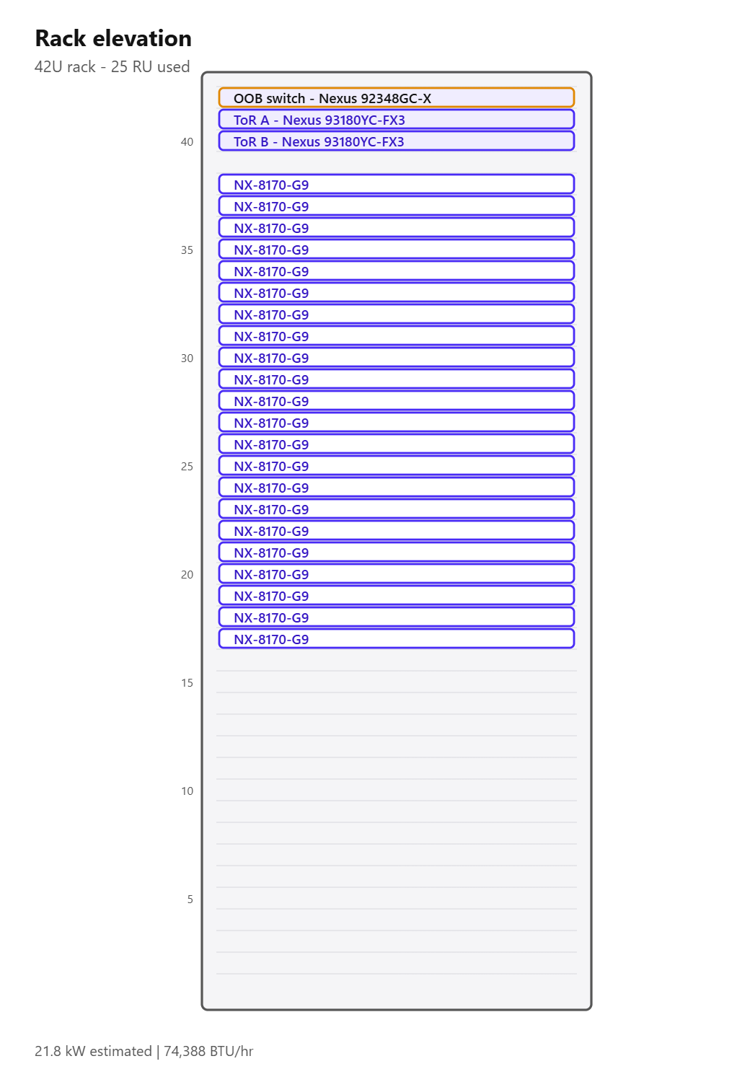
Hardware platform
Nutanix NX-8170-G9 - from the official Nutanix platform spec sheets
Attribute | Value
Vendor | Nutanix
Model | NX-8170-G9
Published CPU options | Dual Intel Xeon 5th Gen. (Emerald Rapids)
Sockets | 2
Max cores per socket (published) | 32
Max memory per node (published) | 4,096 GB
Storage type | All SSD SED, All NVMe SED, All SSD, NVMe+NST, All NVMe
Form factor | 1U1N (1 node per 1U chassis)
Max raw capacity per node (published) | 184.32 TB
Nutanix published use cases | Database and Business Critical Apps, Analytics and Big Data, End-User Computing/Virtual Desktop Infrastructure, Private Cloud, Server Virtualization, IT Apps, Files and Objects
As configured | 2 x 32 cores, 1024 GB, 11.52 TB raw

Slide 9
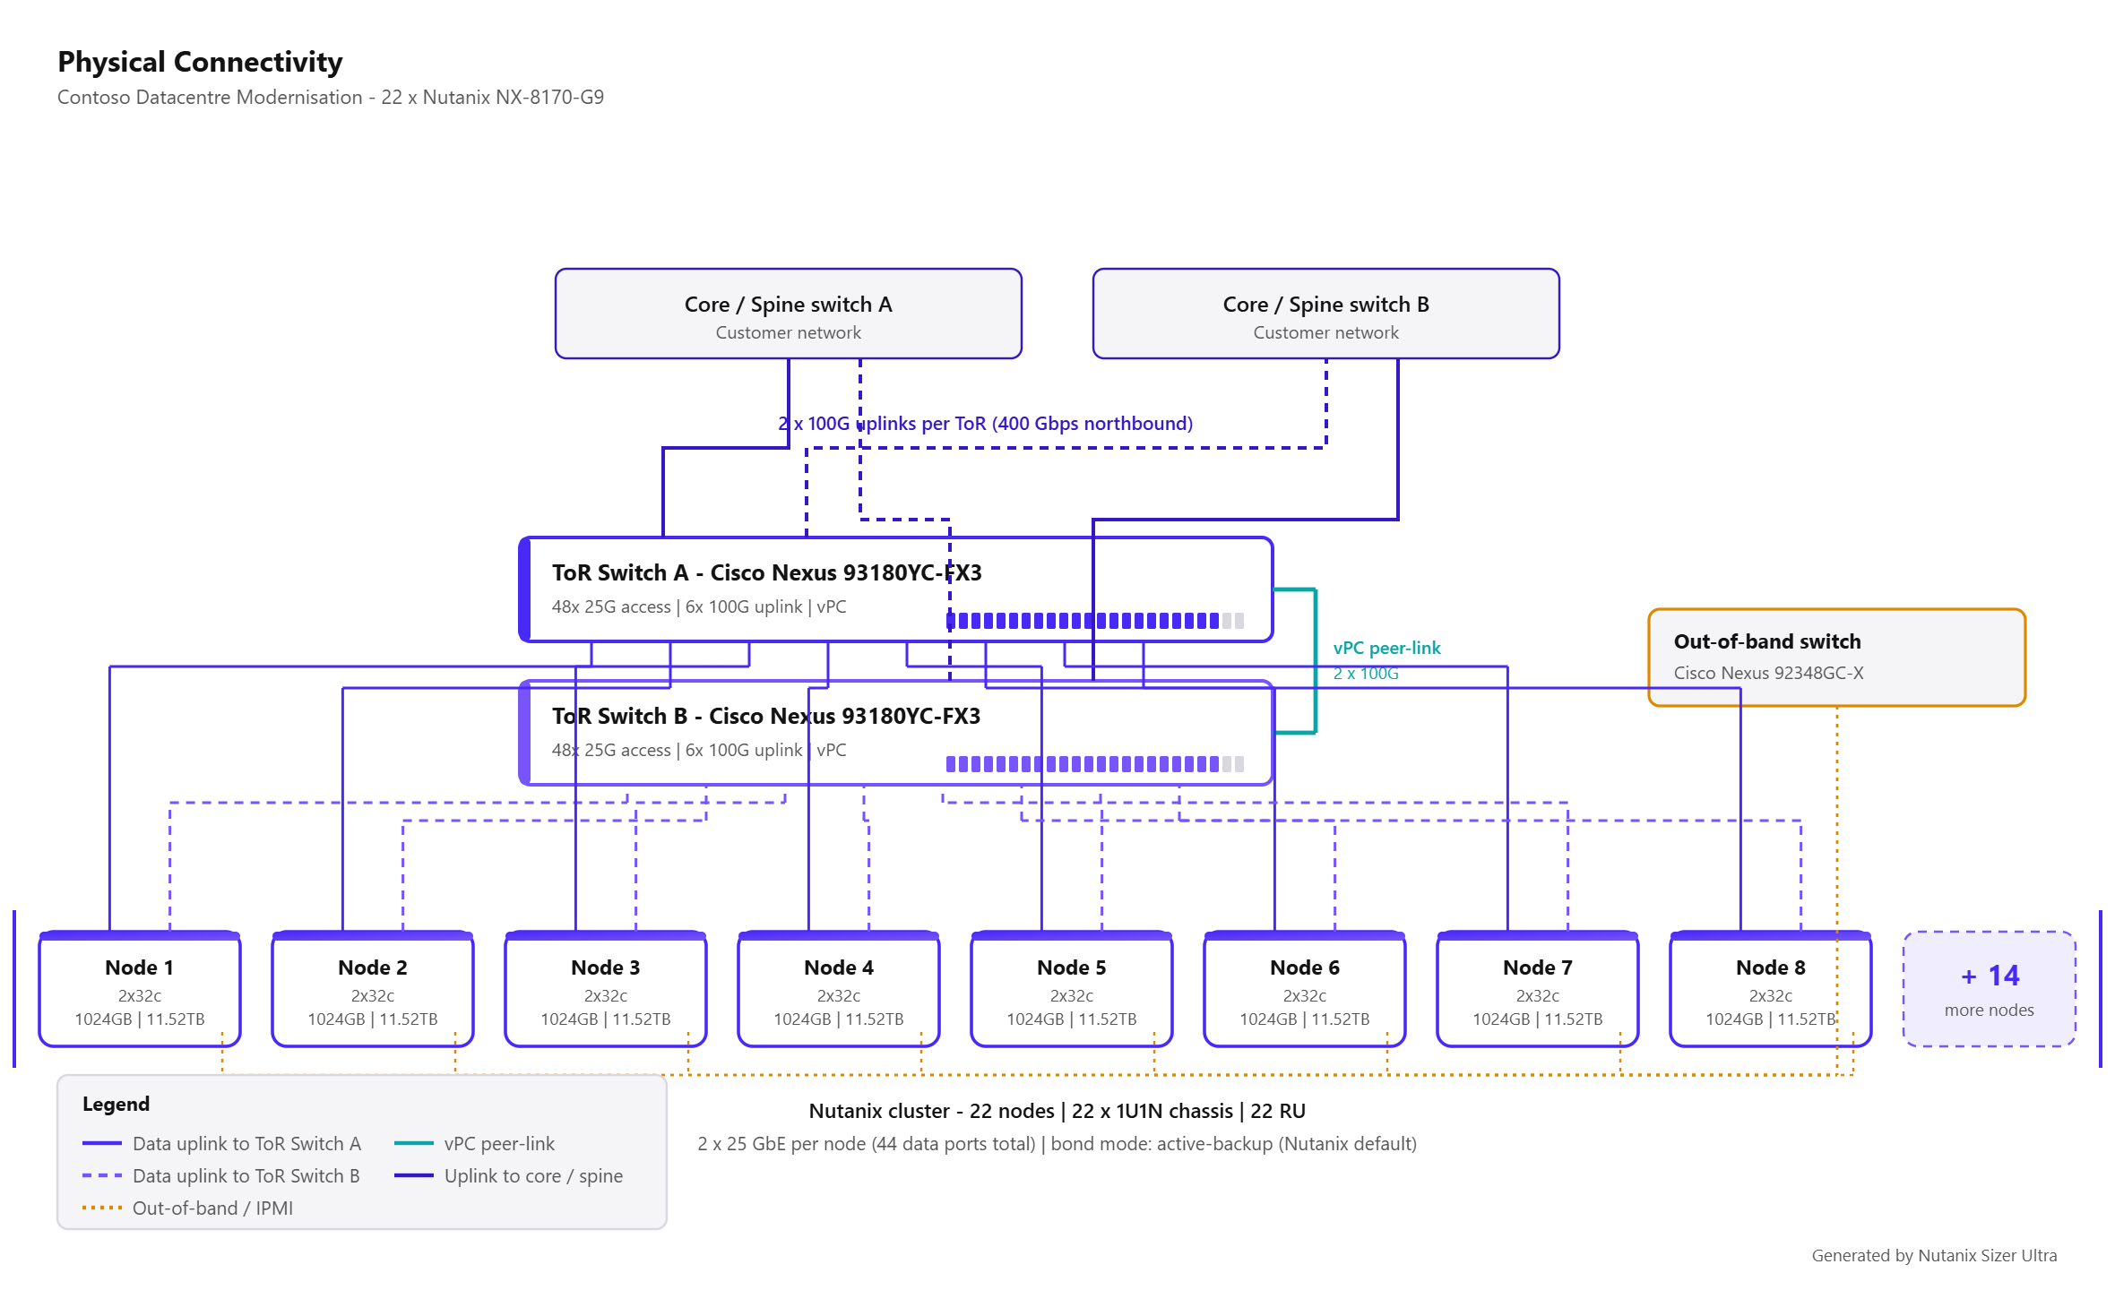
Physical connectivity

Slide 10
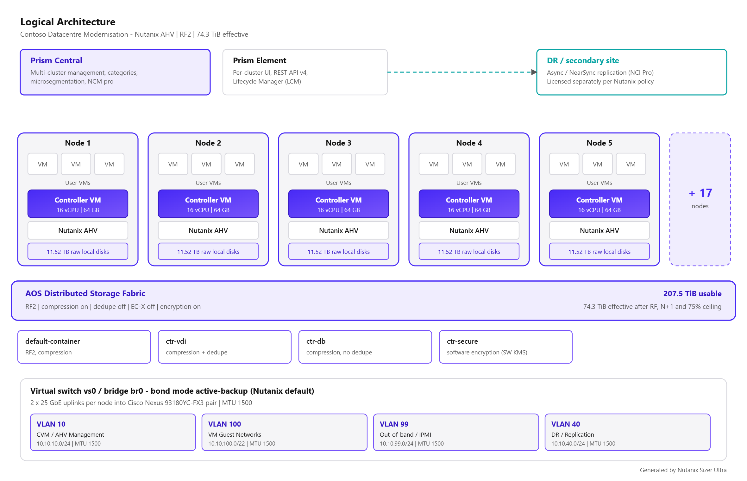
Logical architecture

Slide 11
Network design
Cisco Nexus 93180YC-FX3 x 2 + out-of-band - 1 of 2
Item | Value
Data ToR switch | Cisco Nexus 93180YC-FX3
ToR switch count | 2 (1 redundant pair)
Switch redundancy technology | vPC
Out-of-band switch | Cisco Nexus 92348GC-X x 1
NIC per node | 2 x 25 GbE
Total node data ports | 44
Access port utilisation | 46%
Bond mode | active-backup (Nutanix default)
Switch requirement for bond mode | No MLAG required. Both ToR switches carry the same VLANs.
Uplinks per switch | 2 x 100 G
Northbound bandwidth | 400 Gbps
Node-to-fabric bandwidth | 1,100 Gbps

Slide 12
Network design
Cisco Nexus 93180YC-FX3 x 2 + out-of-band - 2 of 2
Item | Value
MTU | 1500
Data cables | 44
Uplink cables | 4
Peer-link cables | 2
Out-of-band cables | 22

Slide 13
VLAN plan
VLAN | Purpose | Example subnet | MTU | Notes
10 | CVM / AHV Management | 10.10.10.0/24 | 1500 | CVM eth0 and AHV host management. Must be the same L2 for all nodes in a cluster.
20 | Backplane / Storage (optional) | 10.10.20.0/24 | 9000 | Only when network segmentation for the storage backplane is enabled.
100 | VM Guest Networks | 10.10.100.0/22 | 1500 | One or more guest VLANs presented to br0 as AHV networks.
30 | Live Migration (ESXi vMotion) | 10.10.30.0/24 | 9000 | Only for ESXi clusters. AHV live migration uses the management network.
99 | Out-of-band / IPMI | 10.10.99.0/24 | 1500 | IPMI / iDRAC / XCC / CIMC / iRMC. Separate physical switch recommended.
40 | DR / Replication | 10.10.40.0/24 | 1500 | Async / NearSync / Metro replication traffic to the secondary site.

Slide 14
Licensing
NCI Pro - Per physical CPU core
SKU (generic) | Product | Metric | Qty | Term
NCI-PRO-CORE | NCI Pro | Physical CPU core | 1,408 | 36
NCM-PRO-CORE | NCM Pro | Physical CPU core | 1,408 | 36
ADVREP-ADDON | Advanced Replication (Advanced DR) | Physical CPU core | 1,408 | 36

Slide 15
Why this edition
Data-at-rest encryption with native KMS requires NCI Pro or higher.
Cluster of 22 nodes exceeds the 12-node NCI Starter limit.
Multi-site Async / MST replication requires NCI Pro.
Edition | Licensing metric | Max cluster size | Key capabilities
NCI Starter | Per physical CPU core | 12 nodes | AOS distributed storage + AHV hypervisor; Prism Element management, REST APIs, Lifecycle Manager (LCM); Nutanix Insights / Pulse; Native async Disaster Recovery, VM snapshots (1-hour minimum RPO)
NCI Pro | Per physical CPU core | No limit | Everything in Starter; Tunable redundancy - RF2 and RF3; Erasure Coding (EC-X) capacity optimisation; Data-at-rest encryption + native KMS (included from 7.3)
NCI Ultimate | Per physical CPU core | No limit | Everything in Pro; Advanced Replication - Metro Availability, Synchronous and NearSync (RPO = 0); Cross-cluster live migration; Runbook automation / orchestrated DR

Slide 16
Growth projection
12% compound growth per year
Year | Data (TiB) | Nodes
0 | 73.4 | 16
1 | 82.2 | 18
2 | 92.0 | 20
3 | 103.1 | 22
4 | 115.5 | 25
5 | 129.3 | 28

Slide 17
Nutanix best practices
Server Virtualisation
Size every RF2 cluster for N+1 on BOTH compute and storage so a failed node can be fully rebuilt and its VMs restarted.
Minimum 3 nodes for RF2. Use RF3 (minimum 5 nodes) where a double failure must be survivable.
Keep a uniform node model inside a cluster; mixed models are supported but the cluster inherits the lowest common capability.
Default CVM allocation is 12 vCPU / 32 GB RAM. All CVM vCPUs must fit inside a single NUMA socket.
Do not exceed roughly 4:1 vCPU-to-physical-core for general server workloads before validating with real utilisation data.
Enable inline compression on all containers; it is on by default and costs almost nothing on modern CPUs.
Use one storage container per policy (compression/EC/encryption), not one per application.

Slide 18
Nutanix best practices
VDI / End-User Computing
All-flash is strongly recommended for VDI; boot and logon storms are latency-bound, not capacity-bound.
If performance-tier deduplication is enabled, raise CVM memory to 24 GB minimum; inline compression alone needs 16 GB.
Typical density planning: 6:1 vCPU-to-core for knowledge workers, 4:1 for power users, 8:1+ only for task workers.
Size for a 20-25% CPU headroom so a boot storm or a node failure does not saturate the surviving hosts.
Use instant/linked clones so Nutanix deduplication and Shadow Clones can serve the golden image from every node.
Separate the VDI cluster from server workloads when the desktop count exceeds roughly 1,000 seats.
For vGPU-backed desktops select a GPU-capable platform and NCI Pro or higher (vGPU is a Pro feature).

Slide 19
Nutanix best practices
Databases & Business Critical Apps (1)
Nutanix recommends 16 vCPU and 64 GB RAM for the CVM on storage-heavy database nodes (minimum 12 vCPU).
Increase CVM memory to 64 GB for heavy I/O to enlarge the metadata cache and reduce latency.
All CVM vCPUs must fit within a single socket - do not assign more vCPUs than the cores available on one socket.
Do not enable deduplication for database containers; enable inline compression instead.
Keep vCPU-to-core at or below 2:1 for tier-1 databases, and 1:1 for licence-bound or latency-critical instances.
Use all-flash / NVMe platforms and keep the cluster below 75% storage utilisation for consistent latency.
Align database VM vCPU counts to the physical core and NUMA topology of the node to avoid vNUMA fragmentation.

Slide 20
Nutanix best practices
Databases & Business Critical Apps (2)
Consider Nutanix Database Service (NDB) for provisioning, patching and copy-data management.

Slide 21
Nutanix best practices
Private Cloud / Mixed Workload
Use Nutanix Cloud Manager (NCM) for capacity planning, rightsizing, showback and self-service.
Separate clusters by lifecycle (prod / non-prod) rather than by application where possible.
Standardise on one or two node models to keep LCM, spares and licensing simple.
Reserve 20-25% CPU and RAM headroom so rightsizing and burst do not push the cluster into contention.
Use categories and Flow Network Security for tenant isolation (Ultimate, or Pro plus the Security add-on).
Deploy Prism Central as a scale-out 3-VM instance for production private cloud.

Slide 22
Nutanix best practices
Cross-cutting Nutanix design rules (1)
Cluster resiliency: RF2 requires a minimum of 3 nodes; RF3 requires a minimum of 5 nodes. Size N+1 (or N+2 for RF3) so a failed node's VMs restart and its data re-protects.
Storage headroom: Keep steady-state utilisation at or below the configured ceiling. Nutanix flags Data Resiliency as critical when free space drops below the capacity needed to rebuild a node.
CVM: Every node runs a Controller VM. Reserve its vCPU and RAM out of usable host capacity - the default is 12 vCPU / 32 GB, rising to 16 vCPU / 64 GB for database-heavy nodes.
NUMA: All CVM vCPUs must fit inside one physical socket. Do not assign more CVM vCPUs than the cores available on a single socket.
Data efficiency: Inline compression should be on everywhere. Deduplication suits VDI and backup, not databases. EC-X suits cold data and needs 4+ nodes (6+ recommended).
Mixed clusters: NCI editions are set per cluster. A cluster with mixed licences defaults to the lowest tier, so licence every node in a cluster at the same edition.
Networking: Use two leaf/ToR switches with redundant uplinks per node. Nutanix recommends active-backup bonding by default; use balance-tcp (LACP) only with a properly configured MLAG/vPC pair.

Slide 23
Nutanix best practices
Cross-cutting Nutanix design rules (2)
Network speed: 10 GbE is the practical minimum; 25 GbE or faster is recommended for all-flash/NVMe nodes and for any cluster carrying database or VDI workloads.
Out-of-band: Every node needs an IPMI/iDRAC/XCC/CIMC port on a separate management switch or VLAN for Foundation, LCM and remote console.
Lifecycle: Standardise node models per cluster and keep AOS, AHV, firmware and Prism Central on versions validated together by Lifecycle Manager (LCM).

Slide 24
Generic bill of quantities
Hardware - Nutanix cluster nodes
SKU (generic) | Description | Qty | UoM
NUTANIX-NX-8170-G9-NODE | Nutanix NX-8170-G9 node - 2x CPU, 32 cores/socket, 1024 GB RAM, 11.52 TB raw storage | 22 | node
NUTANIX-CPU-32C | CPU - 32 core processor (Dual Intel Xeon 5th Gen. (Emerald Rapids)) | 44 | ea
MEM-32GB | Memory - 32 GB DIMM | 704 | ea
DRV-NVME | Data drives - 1.92 TB NVMe SSD | 132 | ea
NIC-25G-2P | Network adapter - 2 x 25 GbE per node | 22 | ea
RAILKIT-STD | Rail kit / cable management arm | 22 | ea
PWR-C13-C14 | Power cords (redundant PSU feeds) | 44 | ea

Slide 25
Generic bill of quantities
Network - top of rack and out of band
SKU (generic) | Description | Qty | UoM
CISCO-NEXUS93180YC-FX3 | Cisco Nexus 93180YC-FX3 - data ToR switch (48x 25G + 6x 100G) | 2 | ea
CISCO-NEXUS92348GC-X-OOB | Cisco Nexus 92348GC-X - out-of-band management switch | 1 | ea
CAB-25G-SFP28 | Node-to-ToR cabling - 25G SFP28 DAC / optic + LC patch | 44 | ea
CAB-100G-QSFP28 | Switch uplinks to spine/core - 100G QSFP28 DAC / optic | 4 | ea
CAB-100G-QSFP28-PEER | vPC peer-link cabling between the ToR pair | 2 | ea
CAB-1G-RJ45 | Out-of-band cabling - Cat6A copper patch (RJ45) | 22 | ea

Slide 26
Generic bill of quantities
Nutanix software licences
SKU (generic) | Description | Qty | UoM
NCI-PRO-CORE | NCI Pro - Physical CPU core | 1408 | Physical CPU core
NCM-PRO-CORE | NCM Pro - Physical CPU core | 1408 | Physical CPU core
ADVREP-ADDON | Advanced Replication (Advanced DR) - Physical CPU core | 1408 | Physical CPU core

Slide 27
Generic bill of quantities
Support and services
SKU (generic) | Description | Qty | UoM
SUPPORT-PRODUCTION-36M | Nutanix Production support - hardware and software | 22 | node
SVC-FOUNDATION-DEPLOY | Deployment services - Foundation imaging, cluster creation, Prism Central, network integration | 1 | engagement
SVC-MIGRATION-MOVE | Workload migration services (Nutanix Move / cross-hypervisor conversion) | 9 | wave of 100 VMs
SVC-KNOWLEDGE-TRANSFER | Administrator knowledge transfer / handover workshop | 1 | engagement

Slide 28
Generic bill of quantities
Facilities (informational)
SKU (generic) | Description | Qty | UoM
RACK-U | Rack units consumed by Nutanix nodes | 22 | RU
PWR-KW | Estimated peak power draw | 21.8 | kW
COOL-BTU | Estimated heat load | 74388 | BTU/hr

Slide 29
Design validation findings
Severity | Finding
WARN | Projected storage utilisation is 75% - close to the configured ceiling. Little room for unplanned growth.
INFO | Cluster is 22 nodes, which exceeds the 12-node maximum of NCI Starter. NCI Pro or Ultimate is required.

Slide 30
Data sources
Every figure traces back to an official Nutanix source
Nutanix Hardware Platform Spec Sheets - https://www.nutanix.com/products/hardware-platforms/specsheet
Nutanix Cloud Infrastructure (NCI) datasheet - https://www.nutanix.com/library/datasheets/nci
Nutanix licensing and software options - https://www.nutanix.com/products/cloud-platform/software-options
Nutanix Cloud Manager (NCM) datasheet - https://www.nutanix.com/library/datasheets/ncm
Nutanix CVM considerations, Microsoft SQL Server on Nutanix best practice guide (BP-2015)
Oracle on Nutanix best practice guide (BP-2000) - Nutanix configuration
Nutanix Hybrid Cloud Reference Architecture - compute and storage

