Slide 1
Head office VDI endpoint refresh
Thin client selection and design
Recommendation: 263 x Dell Pro Micro Thin Client (Q9M1260) · 100% fit · meets every requirement
Customer: Niyyasoft · Site: Riyadh HQ
Prepared by Niyyasoft · 30 September 2026
Niyya Software · Zero/Thin Client Selector · specifications from each OEM's official website

Slide 2
Executive summary
Dell Technologies · Dell Pro Micro Thin Client (Q9M1260)
For 250 knowledge worker seats on Citrix, the tool scored 233 current models from 29 OEMs against 2 x Full HD displays, a 1 GbE network, optimised Microsoft Teams and the ports, peripherals, management and security asked for. The recommended endpoint is the Dell Pro Micro Thin Client (Q9M1260) from Dell Technologies, running Dell ThinOS 10.x, at 100% fit. It meets every stated requirement on the OEM's published data. 263 endpoints are needed (250 seats plus 13 spares). 22 of the 233 models meet every requirement and 64 more need a value confirming.
100%
fit to requirements
Meets every requirement
263 endpoints · Citrix
Item | Value
Endpoints | 263 (250 seats + 13 spares)
Device | Dell Pro Micro Thin Client (Q9M1260) - Thin client · Desktop box
Operating system | Dell ThinOS 10.x
Fit | 100% - meets every requirement
Platform and protocol | Citrix over Citrix HDX (ICA)
Processor and memory | Intel Processor N150 (4 cores, up to 3.6 GHz); Intel Processor N250 (4 cores, up to 3.8 GHz); …
Head office VDI endpoint refresh · Niyya Software
2

Slide 3
Requirements
What every seat has to deliver
Item | Requirement
Use case | Knowledge worker - 250 users, 5% spares, 80% signed in at peak
VDI platform | Citrix DaaS / Virtual Apps and Desktops - virtual desktops (VDI)
Display protocol | Citrix HDX (ICA) (the platform's own)
Device | Type: thin or zero client; form factor: desktop box; operating system: any
Displays | 2 x Full HD (1920 x 1080) per seat; preferred port: any
Processor, memory, storage | At least 4 cores, 8 GB memory, 16 GB storage (the tool's baseline for this use case)
Network | 1 GbE wired; Wired only; Office, on the campus LAN
Connectivity options | None
USB and ports | At least 4 USB ports
Unified communications | Microsoft Teams - optimised on the endpoint
Peripherals | Webcam, Headset, Printer
Management and security | Central management software, TPM 2.0
OEMs considered | All (35)
Head office VDI endpoint refresh · Niyya Software
3

Slide 4
How it was worked out
Seats, the per-seat baseline, bandwidth and the access network
Step | Working
Seats | 250 users + 5% spares (13) = 263 endpoints to buy
Per-seat baseline | Knowledge worker baseline: 4 cores, 8 GB. A planning rule of thumb, not an OEM figure.
Per-seat minimum used | 4 cores, 8 GB memory, 16 GB storage
Displays | 2 x Full HD per seat = 500 screens in total
USB at the desk | 4 devices: Keyboard, Mouse, Webcam, Headset
Session bandwidth | 0.9 Mbps average per session (knowledge worker, 2 displays at Full HD) x 200 concurrent users (80%) + 50 in calls at 1.5 Mbps = about 255 Mbps on the site uplink. A planning estimate - meas…
Access network | 250 wired ports at 1 GbE; 6 x 48-port access switches with 10% spare ports
ENDPOINTS
SCREENS
PER SEAT
SITE UPLINK
263
500
4 cores · 8 GB
255 Mbps
Head office VDI endpoint refresh · Niyya Software
4

Slide 5
Recommended device
Dell Pro Micro Thin Client (Q9M1260) · Thin client · Desktop box
Criterion | Weight | Score
VDI platform & protocol | 20 | 100%
Device type & OS | 9 | 100%
Displays | 14 | 100%
CPU, memory & storage | 13 | 100%
Network & connectivity | 10 | 100%
USB & ports | 7 | 100%
Teams / UC, camera & audio | 10 | 100%
Peripherals | 5 | 100%
Management & security | 6 | 100%
Use-case suitability | 4 | 100%
Model currency | 2 | 100%
Dell's current fanless micro thin client with up to an 8-core Intel N-series CPU, a swappable rear expansion module (fibre, second NIC, serial, extra video) and support for up to five displays.
Operating system: Dell ThinOS 10.x
Fit: 100% - meets every requirement
Platform and protocol: Citrix over Citrix HDX (ICA)
Processor and memory: Intel Processor N150 (4 cores, up to 3.6 GHz); Intel Processor N250 (4 cores, up to 3.8 GHz); Intel…
Displays: 5 displays, up to 3840x2160@60 · 2 x DisplayPort, 1 x USB-C (DP Alt)
USB and network: 3 x USB 2.0, 1 x USB 3.x, 2 x USB-C · 1 GbE, Wi-Fi 7
Source: https://www.dell.com/en-us/shop/wyse-endpoints-and-software/dell-pro-micro-thin-client/spd/del…
Head office VDI endpoint refresh · Niyya Software
5

Slide 6
Bill of materials
250 seats plus 13 spares
Item | Specification | Quantity
Endpoint | Dell Pro Micro Thin Client (Q9M1260) (Thin client · Desktop box) - 250 seats + 13 spares | 263
Operating system | Dell ThinOS 10.x | 263
Memory | 8 GB DDR5 SO-DIMM (1 module, 4800 MT/s) | 263
Storage | At least 16 GB - 128 GB UFS (M.2 2230) or 256 GB M.2 2230 PCIe NVMe SSD | 263
Monitor | Full HD (1920 x 1080) monitor, 2 per seat | 500
Video cable | To match the device outputs: 2 x DisplayPort, 1 x USB-C (DP Alt) | 500
Keyboard and mouse | USB keyboard and mouse set | 250
Webcam | USB webcam (UVC), Full HD | 250
Headset | Microsoft Teams-certified headset, USB or 3.5 mm | 250
Management software | Wyse Management Suite - one managed device each | 263
VDI client | Citrix Workspace app for Citrix, as included with or installed on Dell ThinOS 10.x | 263
Head office VDI endpoint refresh · Niyya Software
6

Slide 7
Bill of materials (cont.)
250 seats plus 13 spares
Item | Specification | Quantity
Access switch port | 1 GbE port and patch cable | 250
Head office VDI endpoint refresh · Niyya Software
7

Slide 8
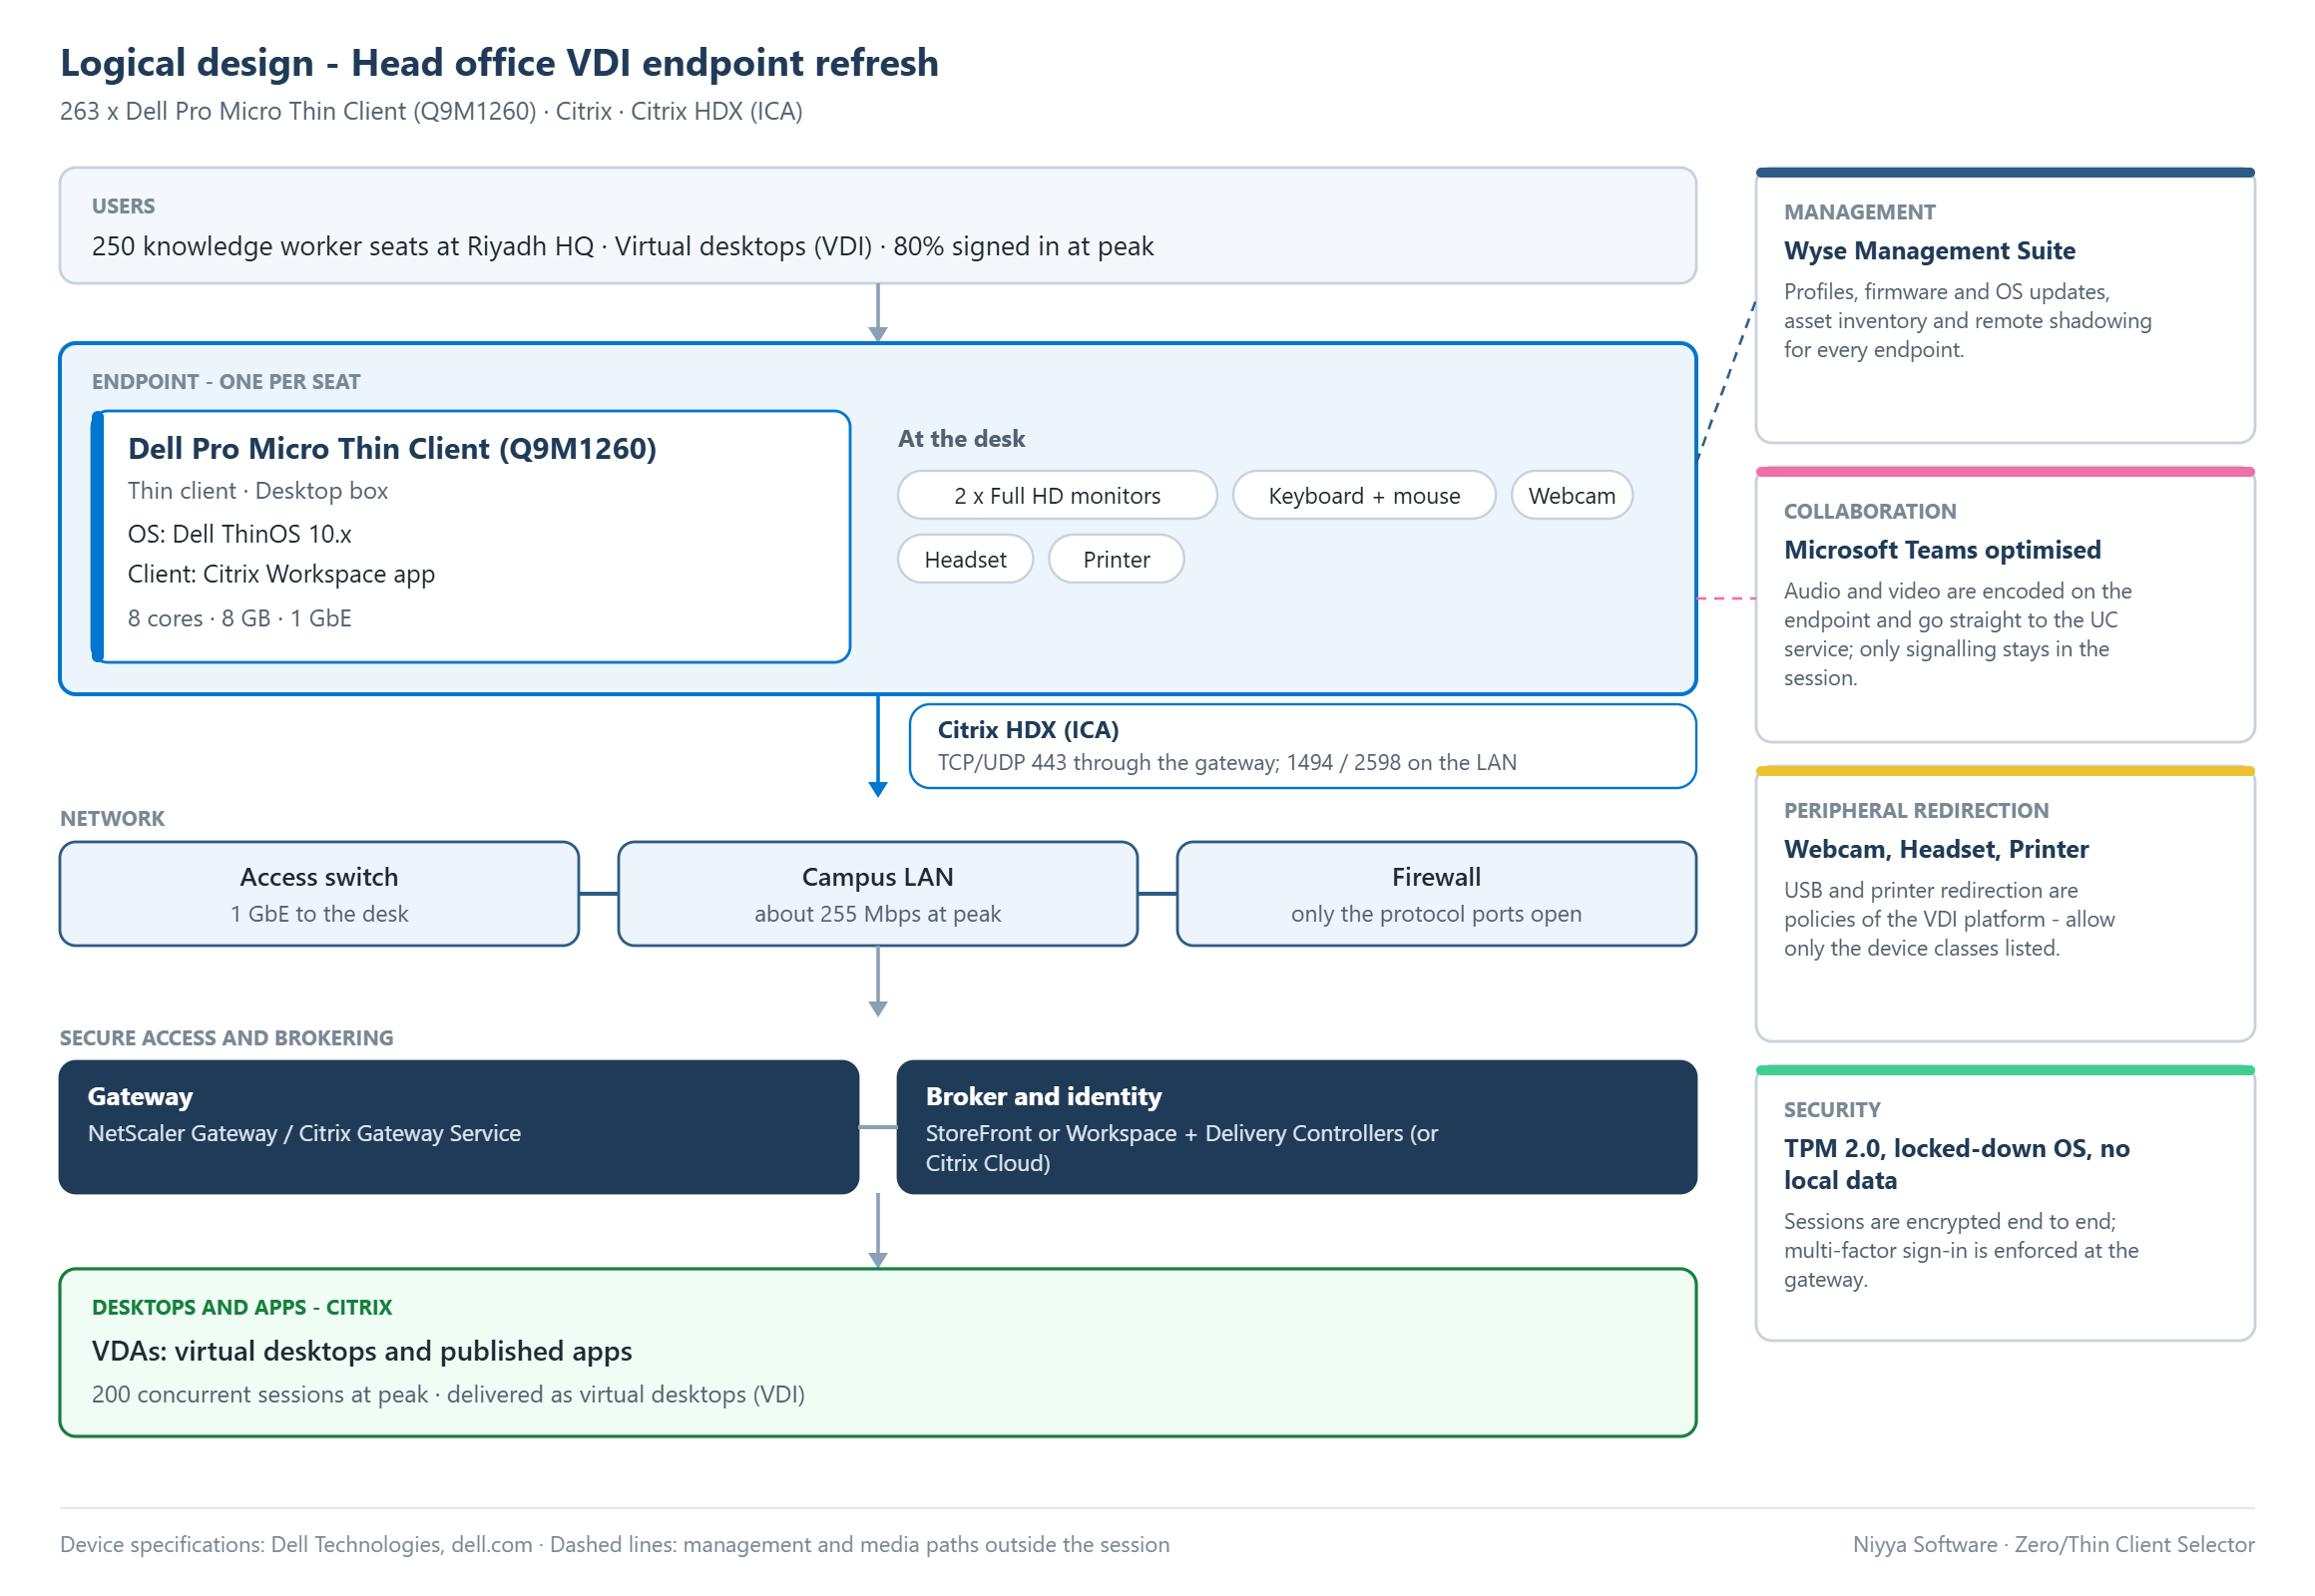
Logical design
Users, endpoint, network, gateway and broker, desktops and apps
Head office VDI endpoint refresh · Niyya Software
8

Slide 9
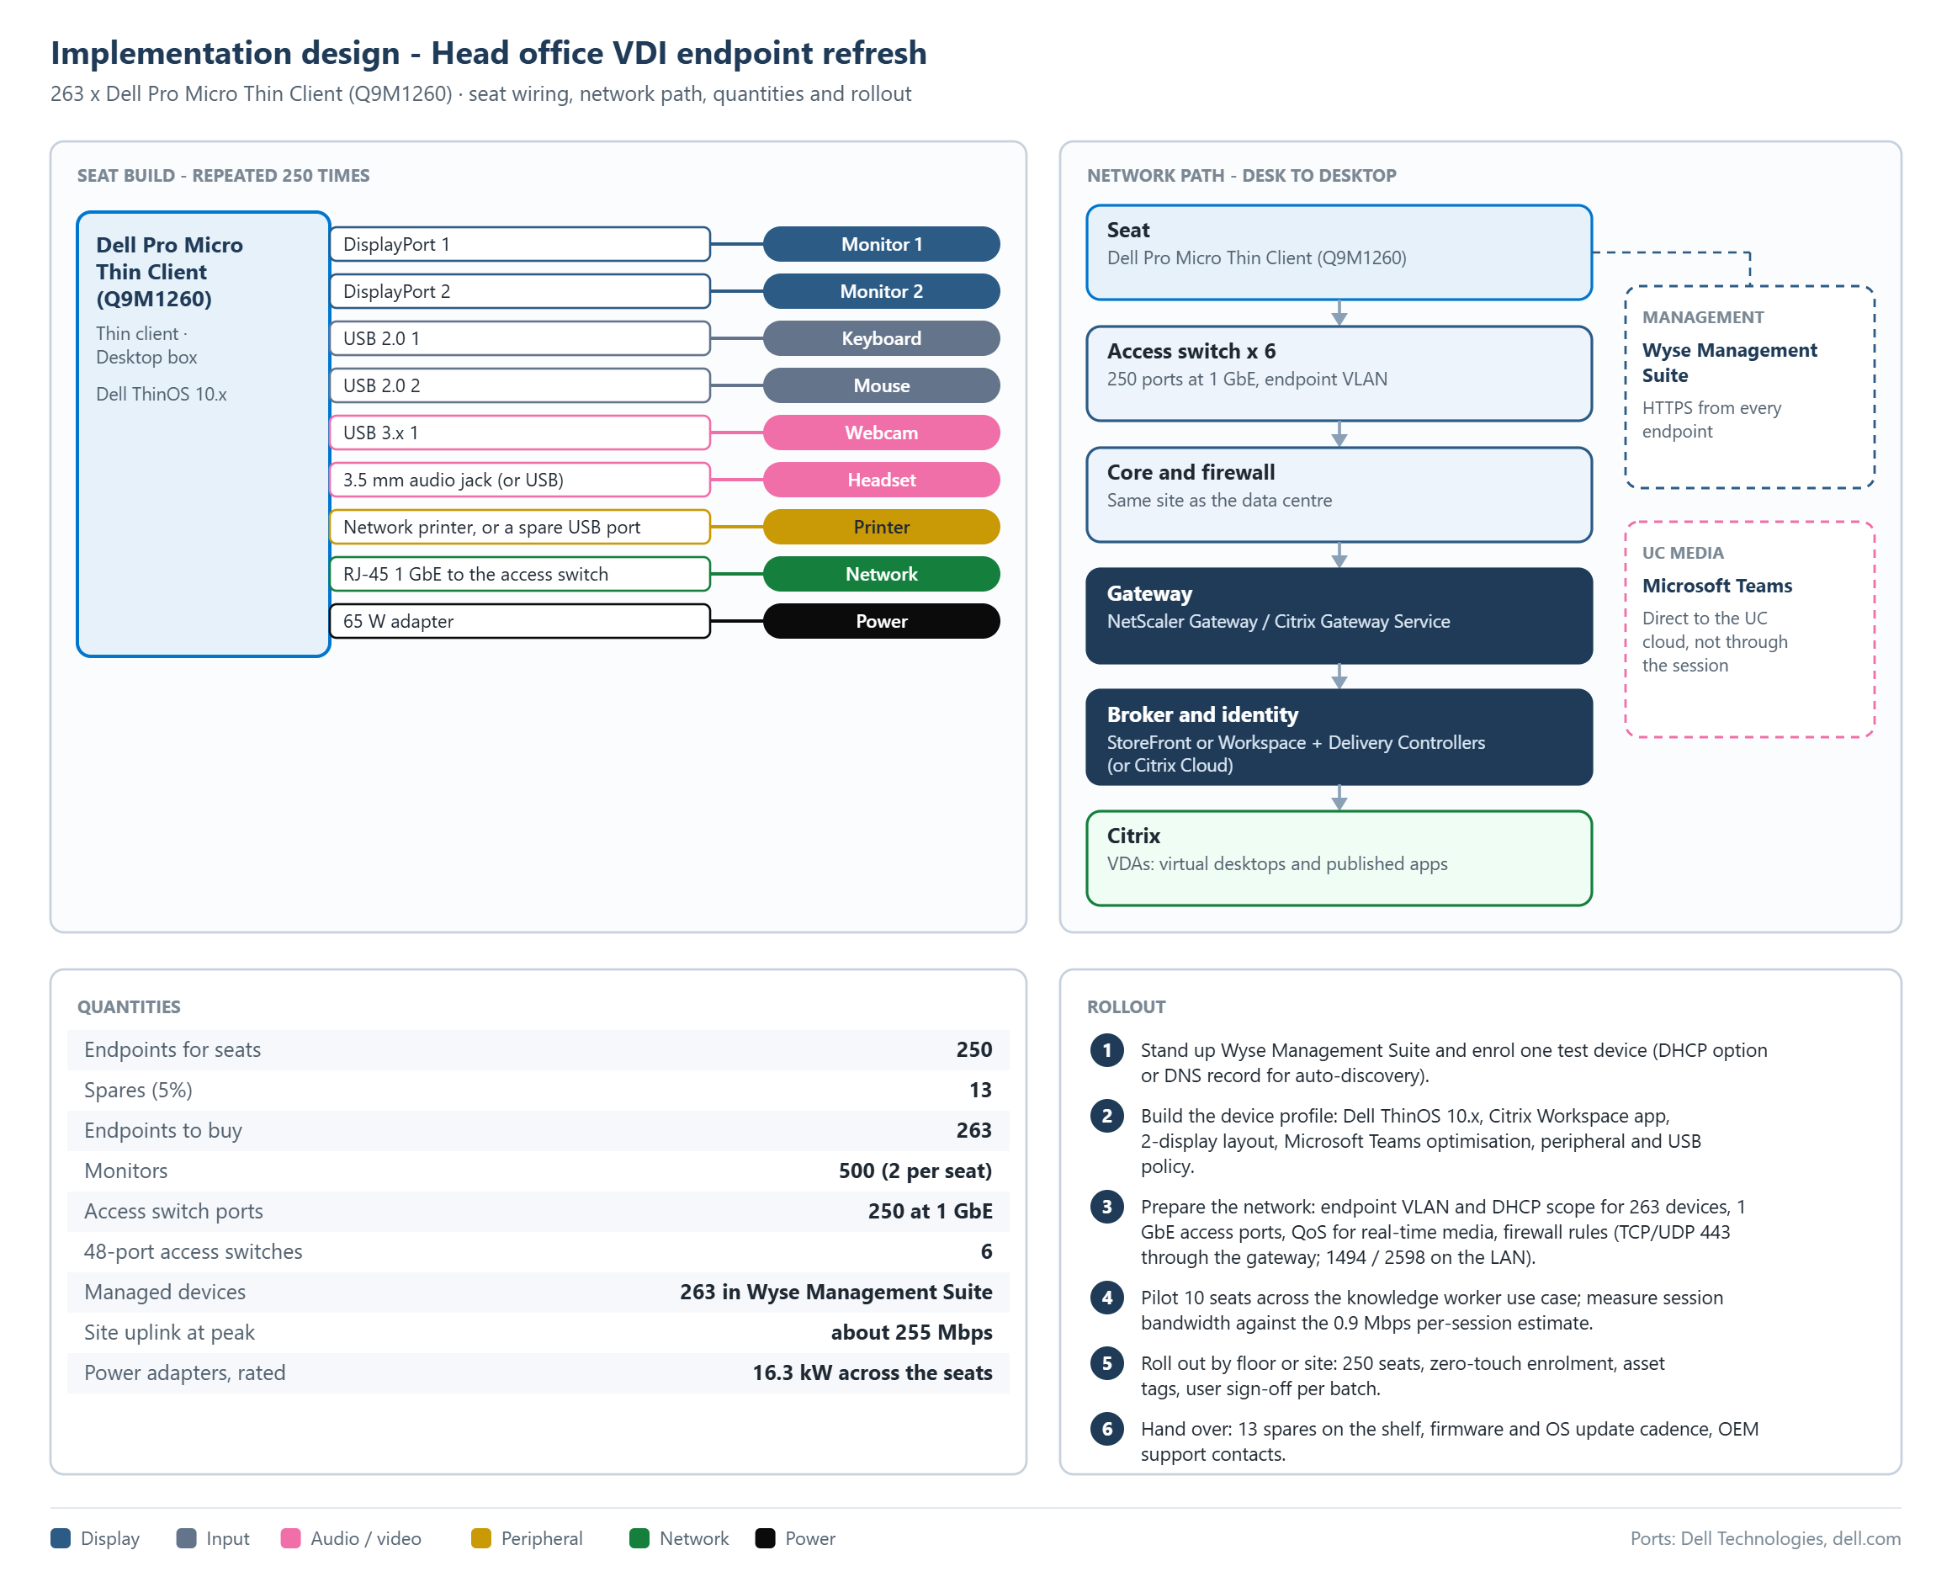
Implementation design
Seat wiring, network path, quantities and rollout
Head office VDI endpoint refresh · Niyya Software
9

Slide 10
Seat build and quantities
Which plug goes in which port, and how many of everything
Connects | Port on the device
Monitor 1 | DisplayPort 1
Monitor 2 | DisplayPort 2
Keyboard | USB 2.0 1
Mouse | USB 2.0 2
Webcam | USB 3.x 1
Headset | 3.5 mm audio jack (or USB)
Printer | Network printer, or a spare USB port
Network | RJ-45 1 GbE to the access switch
Power | 65 W adapter
Item | Quantity
Endpoints for seats | 250
Spares (5%) | 13
Endpoints to buy | 263
Monitors | 500 (2 per seat)
Access switch ports | 250 at 1 GbE
48-port access switches | 6
Managed devices | 263 in Wyse Management Suite
Site uplink at peak | about 255 Mbps
Power adapters, rated | 16.3 kW across the seats
Head office VDI endpoint refresh · Niyya Software
10

Slide 11
Rollout
From the management console to hand-over
1. Stand up Wyse Management Suite and enrol one test device (DHCP option or DNS record for auto-discovery).
2. Build the device profile: Dell ThinOS 10.x, Citrix Workspace app, 2-display layout, Microsoft Teams optimisation, peripheral and USB policy.
3. Prepare the network: endpoint VLAN and DHCP scope for 263 devices, 1 GbE access ports, QoS for real-time media, firewall rules (TCP/UDP 443 through the gateway; 1494 / 2598 on the LAN).
4. Pilot 10 seats across the knowledge worker use case; measure session bandwidth against the 0.9 Mbps per-session estimate.
5. Roll out by floor or site: 250 seats, zero-touch enrolment, asset tags, user sign-off per batch.
6. Hand over: 13 spares on the shelf, firmware and OS update cadence, OEM support contacts.
Head office VDI endpoint refresh · Niyya Software
11

Slide 12
Best model from each OEM
Highest fit per vendor for the same requirements
OEM | Model | Type | Fit | Status | To resolve
Dell | Dell Pro Micro Thin Client (Q9M12… | Thin client · Desktop box | 100% | Meets | -
HP | HP Elite t655 Thin Client | Thin client · Desktop box | 100% | Meets | -
Praim | Meridian (M9354 / M9311 / M9321) | Thin client · Desktop box | 99% | Meets | -
10ZiG | 7300q Series (7372q / 7311q) | Thin client · Desktop box | 98% | Meets | -
Lenovo | ThinkCentre M75q Gen 5 | Thin client · Desktop box | 97% | Meets | -
LG | CQ601 (CQ601N / CQ601I / CQ601W) | Thin client · Desktop box | 97% | Meets | -
Centerm | D650 | Thin client · Desktop box | 97% | To confirm | Confirm: optimised Microsoft Teams on Windows IoT is inferred…
ZeeTim | ZeeTerm ZTX6002 | Thin client · Desktop box | 97% | To confirm | Confirm: tPM is not published
NComputing | EX500S | Thin client · Desktop box | 96% | To confirm | Confirm: tPM is not published
Rangee | Rangee Thin Client RT-603 | Thin client · Desktop box | 96% | To confirm | Confirm: tPM is not published
ClearCube | CD8810 | Thin client · Desktop box | 96% | To confirm | Confirm: tPM is not published
Head office VDI endpoint refresh · Niyya Software
12

Slide 13
Best model from each OEM (cont.)
Highest fit per vendor for the same requirements
OEM | Model | Type | Fit | Status | To resolve
Atrust | t175W | Thin client · Desktop box | 96% | To confirm | Confirm: optimised Microsoft Teams on Windows IoT is inferred…
Chip PC | iX PC Core Wifi | Thin client · Desktop box | 95% | To confirm | Confirm: optimised Microsoft Teams on Windows IoT is inferred…
Leadtek | EL4115 Ultra-Thin Client | Thin client · Desktop box | 95% | To confirm | Confirm: optimised Microsoft Teams on Windows IoT is inferred…
Fujitsu | ESPRIMO G6016-TC | Thin client · Desktop box | 95% | To confirm | Confirm: optimised Microsoft Teams on Windows IoT is inferred…
Amulet Hotkey | DX1500 | Thin client · Desktop box | 94% | To confirm | Confirm: processor core count is not published
OnLogic | TM260 | Zero client · Desktop box | 91% | To confirm | Confirm: optimised Microsoft Teams support is not published; …
Clientron | G610 | Thin client · Desktop box | 90% | To confirm | Confirm: optimised Microsoft Teams on Windows IoT is inferred…
openthinclient | ThinClient BLACK.QUADRO.II | Thin client · Desktop box | 88% | To confirm | Confirm: wired Ethernet speed is not published; Confirm: opti…
Pepperl+Fuchs | BTC22 | Thin client · Desktop box | 84% | Short | 1 USB port; 4 needed; Confirm: processor core count is not pu…
epatec | Thin Client 13G | Thin client · Desktop box | 83% | Short | 4 GB memory at most; 8 GB recommended for this use case; Conf…
RDP | RDP Thin Client C212261 | Thin client · Desktop box | 79% | Short | 1 USB port; 4 needed; Confirm: maximum resolution is not publ…
Head office VDI endpoint refresh · Niyya Software
13

Slide 14
Best model from each OEM (cont.)
Highest fit per vendor for the same requirements
OEM | Model | Type | Fit | Status | To resolve
Raspberry Pi | Raspberry Pi 500 | Thin client · Desktop box | 77% | Short | 3 USB ports; 4 needed; Confirm: vDI platform support is not p…
Advantech | TPC-312 EHL | Thin client · All-in-one 12.1" | 49% | Short | Is all-in-one, not desktop box; Confirm: number of displays s…
Microsoft | Windows 365 Link | Thin client · Desktop box | 49% | Short | No Citrix support published (lists Windows 365); Confirm: pro…
Rockwell | ASEM 6300T-BB Dual DisplayPort Th… | Zero client · Desktop box | 49% | Short | No Citrix support published (lists Other); Confirm: optimised…
IGEL | IGEL UD Pocket 2 | Thin client · Stick / board | 49% | Short | Is stick / board, not desktop box; 0 USB ports; 4 needed; No …
vCloudPoint | V1 | Zero client · Desktop box | 49% | Short | No Citrix support published (lists vCloudPoint vMatrix); Driv…
Thinvent | Thinvent Micro 6 Pro | Thin client · Desktop box | 49% | Short | No Citrix support published (lists Microsoft RDP, Terminal em…
Head office VDI endpoint refresh · Niyya Software
14

Slide 15
Model comparison
Recommended: Dell Pro Micro Thin Client (Q9M1260) at 100% fit
 | Dell Pro Micro Thin Cl… | HP Elite t655 Thin Cli… | Praim Meridian (M9354 … | 10ZiG 7300q Series (73… | Lenovo ThinkCentre M75…
Fit | 100% | 99.8% | 99.2% | 98.4% | 97.4%
Status | Meets | Meets | Meets | Meets | Meets
VDI platform & protocol | 100% | 100% | 100% | 100% | 100%
Device type & OS | 100% | 100% | 100% | 100% | 100%
Displays | 100% | 100% | 100% | 100% | 100%
CPU, memory & storage | 100% | 100% | 100% | 100% | 100%
Network & connectivity | 100% | 100% | 100% | 100% | 100%
USB & ports | 100% | 100% | 100% | 100% | 100%
Teams / UC, camera & a… | 100% | 100% | 94% | 94% | 92%
Peripherals | 100% | 100% | 100% | 80% | 80%
Management & security | 100% | 100% | 100% | 100% | 100%
Use-case suitability | 100% | 100% | 100% | 100% | 82%
Model currency | 100% | 90% | 90% | 100% | 100%
Head office VDI endpoint refresh · Niyya Software
15

Slide 16
Model comparison (cont.)
Recommended: Dell Pro Micro Thin Client (Q9M1260) at 100% fit
 | Dell Pro Micro Thin Cl… | HP Elite t655 Thin Cli… | Praim Meridian (M9354 … | 10ZiG 7300q Series (73… | Lenovo ThinkCentre M75…
Type | Thin client · Desktop … | Thin client · Desktop … | Thin client · Desktop … | Thin client · Desktop … | Thin client · Desktop …
Operating systems | Dell ThinOS, Windows I… | Vendor Linux, Windows … | Vendor Linux, Windows … | Vendor Linux, Windows … | IGEL OS, Windows IoT E…
Processor | Intel Processor N150 (… | AMD Ryzen Embedded R23… | Intel N97 Quad-Core up… | Intel N100 Quad Core u… | AMD Ryzen 3 / 5 8000 o…
Memory | 8 - 16 GB DDR5 SO-DIMM… | 4 - 32 GB DDR4 SODIMM … | 8 - 16 GB | 8 - 16 GB | 64 GB DDR5-5200 SO-DIM…
Displays / max resolut… | 5 / 3840x2160@60 | 3 / 3840x2160@60 | 3 / 4096x2160@60 | 3 / 4096x2160@60 | 4 / 4096x2160@60
Video outputs | 2 x DisplayPort, 1 x U… | 3 x DisplayPort | 3 x DisplayPort | 2 x HDMI, 1 x USB-C (D… | 1 x DisplayPort, 1 x H…
USB | 3 x USB 2.0, 1 x USB 3… | 2 x USB 2.0, 4 x USB 3… | 4 x USB 2.0, 2 x USB 3… | 2 x USB 2.0, 2 x USB 3… | 3 x USB 2.0, 3 x USB 3…
Network | 1 GbE, Wi-Fi 7 | 1 GbE, Wi-Fi 6 | 1 GbE, Wi-Fi 6E | 1 GbE, Wi-Fi 6 | 1 GbE, Wi-Fi 7
VDI platforms | Citrix, Omnissa Horizo… | Citrix, Omnissa Horizo… | Citrix, Omnissa Horizo… | Citrix, Omnissa Horizo… | Citrix, Omnissa Horizo…
Optimised UC | Microsoft Teams, Zoom,… | Microsoft Teams, Zoom,… | Microsoft Teams, Zoom,… | Microsoft Teams, Zoom,… | Microsoft Teams, Zoom,…
Management | Wyse Management Suite | HP Wolf Cloud Endpoint… | ThinMan | 10ZiG Manager | IGEL management (IGEL …
Head office VDI endpoint refresh · Niyya Software
16

Slide 17
Assumptions
Read these before you quote
Specifications were read from each OEM's own website; options vary by region and change with OS and firmware releases.
A value an OEM does not publish is shown as "to confirm" and scored low - it is never assumed to be supported.
Platform or Teams support marked "via OS" is what the operating system's vendor lists; "inferred" means Windows IoT Enterprise runs the Windows client and the OEM does not state it itself.
The per-seat CPU and memory baseline and the bandwidth figures are planning rules of thumb, not OEM figures - validate them in a pilot.
USB and printer redirection, and optimised Teams, Zoom or Webex, also depend on the VDI platform version and its policies.
Licences for the VDI platform, Microsoft 365 and the endpoint operating system are outside the scope of this selection.
Head office VDI endpoint refresh · Niyya Software
17

Slide 18
Official sources
Every specification links back to the OEM's own website
Model | Official product page | Datasheet
Dell Pro Micro Thin Client (Q9M1260) | https://www.dell.com/en-us/shop/wyse-endpoints-and-software/dell-pro-micro-thin… | https://www.delltechnologies.com/asset/en-us/products/thin-…
HP Elite t655 Thin Client | https://h20195.www2.hp.com/v2/GetDocument.aspx?docname=c08327446 | https://h20195.www2.hp.com/v2/GetDocument.aspx?docname=c086…
Praim Meridian (M9354 / M9311 / M9321) | https://www.praim.com/en/solutions/thinclient/meridian/ | https://www.praim.com/wp-content/uploads/2025/04/Meridian-d…
10ZiG 7300q Series (7372q / 7311q) | https://www.10zig.com/product/solutions/thin-clients/7300q-series/ | https://www.10zig.com/wp-content/uploads/2026/08/7300q-Seri…
Lenovo ThinkCentre M75q Gen 5 | https://psref.lenovo.com/Product/ThinkCentre/ThinkCentre_M75q_Gen_5 | https://psref.lenovo.com/syspool/Sys/PDF/ThinkCentre/ThinkC…
LG CQ601 (CQ601N / CQ601I / CQ601W) | https://www.lg.com/global/business/monitors-pcs/thin-clients/desktop-thin-clien… | https://media.us.lg.com/m/477f7ca62f07dbc6/original/CQ601W-…
Centerm D650 | https://www.centermclient.com/uploads/Centerm-D650-datasheet.pdf | https://www.centermclient.com/uploads/Centerm-D650-datashee…
ZeeTim ZeeTerm ZTX6002 | https://zeetim.com/products/thin-client-zeeterm | -
NComputing EX500S | https://www.ncomputing.com/documentation/datasheet/ex500w-datasheet/249046 | https://ncomputing.box.com/shared/static/f4xx38z27g20z40f6b…
Rangee Thin Client RT-603 | https://rangee.com/en/rangee-thin-client-rt-603/ | https://rangee.com/wp-content/uploads/2026/02/Rangee_Datash…
ClearCube CD8810 | https://clearcube.com/products/thin-clients/cd8810/ | https://images.clearcube.com/wp-content/uploads/2026/03/041…
Atrust t175W | https://www.atrustcorp.com/products/t175w/ | https://www.atrustcorp.com/wp-content/uploads/2022/04/t175W…
Head office VDI endpoint refresh · Niyya Software
18

Slide 19
Official sources (cont.)
Every specification links back to the OEM's own website
Model | Official product page | Datasheet
Chip PC iX PC Core Wifi | https://chippc.com/product/ix-pc-mini-5100-wifi-thinx-os/ | -
Leadtek EL4115 Ultra-Thin Client | https://www.leadtek.com/eng/products/virtual_DS(24)/EL4115_Ultra-Thin_Client(40… | -
Fujitsu ESPRIMO G6016-TC | https://jp.fujitsu.com/platform/pc/product/specific_use/thinclient_model/g6016t… | -
Amulet Hotkey DX1500 | https://www.amulethotkey.com/product/dx1500/ | https://www.amulethotkey.com/wp-content/uploads/2026/02/DX1…
OnLogic TM260 | https://www.onlogic.com/store/tm260/ | https://media.onlogic.com/248f8472-1b41-4a43-9f88-4aee598a9…
Clientron G610 | https://www.clientron.com/en/product.php?act=view&id=79 | https://www.clientron.com/data/file/202607/1784518880441507…
openthinclient ThinClient BLACK.QUADRO.… | https://openthinclient.com/en/product-2/nvidia-quadro-2-thin-client/ | -
Pepperl+Fuchs BTC22 | https://www.pepperl-fuchs.com/en/landingpage/explosion-protection/industrial-bo… | https://files.pepperl-fuchs.com/webcat/navi/productInfo/doc…
epatec Thin Client 13G | https://www.epatec.de/shop/thin-client-13g-70 | -
RDP Thin Client C212261 | https://rdp.in/corporate/thin-clients | -
Raspberry Pi 500 | https://www.raspberrypi.com/products/raspberry-pi-500/ | https://pip.raspberrypi.com/documents/RP-008349-DS-raspberr…
Advantech TPC-312 EHL | https://www.advantech.com/en-us/products/2f7a6598-a2be-40d6-b615-adb84b164442/t… | https://advdownload.advantech.com/productfile/PIS/TPC-312%2…
Head office VDI endpoint refresh · Niyya Software
19

Slide 20
Official sources (cont.)
Every specification links back to the OEM's own website
Model | Official product page | Datasheet
Microsoft Windows 365 Link | https://learn.microsoft.com/en-us/windows-365/link/whats-in-the-box | -
Rockwell ASEM 6300T-BB Dual DisplayPort… | https://www.rockwellautomation.com/en-us/products/hardware/industrial-computers… | https://literature.rockwellautomation.com/idc/groups/litera…
IGEL UD Pocket 2 | https://kb.igel.com/en/hardware/current/technical-specification-of-ud-pocket-2 | -
vCloudPoint V1 | https://www.vcloudpoint.com/zero-clients/zero-client-comparison/ | https://www.vcloudpoint.com/wp-content/uploads/documentatio…
Thinvent Micro 6 Pro | https://www.thinvent.in/p/P-6P-o4-e64-5_2P-D-Thinux-0 | -
Head office VDI endpoint refresh · Niyya Software
20

