Slide 1

VxRail Sizing
VxRail refresh - core cluster
Niyyasoft · 2026-09-20
Prepared by Niyyasoft

Slide 2
Executive summary
Recommended cluster
Usable vSAN capacity
Cores / memory
Licensed cores (VCF)
5 x VE-670
22.6 TiB
240 cores
240
5U · standard
34.9 TiB raw
3,840 GB RAM
vSAN add-on 0 TiB
Per node: 1 x 48-core CPU, 768 GB memory, 4 x 1.92 TB NVMe, 4 x 25GbE networking.
vSAN ESA, RAID-5 FTT=1 adaptive (2+1): 34.9 TiB raw, 22.6 TiB usable (1.5:1 data reduction assumed).
Workload: 100 VMs, 542 vCPU, 2,167 GB RAM, 20.2 TiB storage including 3-year growth and management VMs.
Utilisation after failure: CPU 78%, memory 78%; vSAN capacity 89%. Node count driven by cpu.
VxRail Sizer (VXRS) · VxRail refresh - core cluster
2

Slide 3
Workloads
Workload group | VMs | vCPU | RAM GB | Storage TiB
General purpose VMs | 100 | 400 | 1,600.00 | 14.65
VxRail Sizer (VXRS) · VxRail refresh - core cluster
3

Slide 4
Design policies
Parameter | Value
Cluster type | standard
vSAN architecture / release | ESA / 9.0
Storage policy | RAID-5 FTT=1 adaptive (2+1)
Data reduction assumption | 1.5:1
+1 host for rebuild | Yes
HA (compute) | N+1
vCPU : pCore | 4:1
Max CPU utilisation | 80%
vSAN CPU overhead | 10%
Memory overcommit | 1:1
Max memory utilisation | 90%
ESXi + vSAN memory reserve | 10%
Growth | 10% per year for 3 years
vCenter on cluster | Small
VMware subscription | VMware Cloud Foundation
VxRail Sizer (VXRS) · VxRail refresh - core cluster
4

Slide 5
Recommended configuration
Item | Qty | Detail
VxRail VE-670 node | 5 | PowerEdge R670, 1U
Processor | 5 | 1 x Intel Xeon 6 - 48 cores (48 cores) per node
Memory | 5 | 768 GB per node
vSAN ESA NVMe drives | 20 | 4 x 1.92 TB NVMe per node
Network ports | 20 | 4 x 25GbE per node (OCP + PCIe)
Boot device | 5 | Dell BOSS (mirrored M.2) per node
VxRail Sizer (VXRS) · VxRail refresh - core cluster
5

Slide 6
Utilisation and sizing drivers
Dimension | Required | Utilisation | After failure | Nodes needed
CPU | 135.6 cores | 62.8% | 78.5% | 5
Memory | 2,167 GB | 62.7% | 78.4% | 5
Storage | 20.2 TiB | 89.3% | — | 5
Policy / availability | — | — | — | 4
VxRail Sizer (VXRS) · VxRail refresh - core cluster
6

Slide 7
Capacity and licensing
Metric | Value
Physical cores | 240
Memory | 3,840 GB
Raw capacity | 38.40 TB (34.92 TiB)
Operations reserve + host rebuild reserve | -12.30 TiB
After protection (RAID-5 FTT=1 adaptive (2+1)) | 15.08 TiB
Effective usable (1.5:1) | 22.63 TiB
Edition | VCF
Physical cores | 240
Licensed cores (min 16/CPU) | 240
Included vSAN (1 TiB/core) | 240.00 TiB
Raw vSAN capacity | 34.92 TiB
vSAN add-on required | 0 TiB
VxRail Sizer (VXRS) · VxRail refresh - core cluster
7

Slide 8
Network design
2 x S5248F-ON ToR · N3248TE-ON OOB

Slide 9
VLANs
Network | VLAN | Subnet | Gateway | MTU
External management (ESXi, VxRail Manager, vCenter) | native | 192.168.10.0/24 | 192.168.10.1 | 1500
VxRail internal management (node discovery) | 3939 |  |  | 1500
vSphere vMotion | 20 | 192.168.20.0/24 |  | 9000
vSAN | 30 | 192.168.30.0/24 |  | 9000
VM / guest network | 100 | 192.168.100.0/24 | 192.168.100.1 | 1500
VxRail Sizer (VXRS) · VxRail refresh - core cluster
9

Slide 10
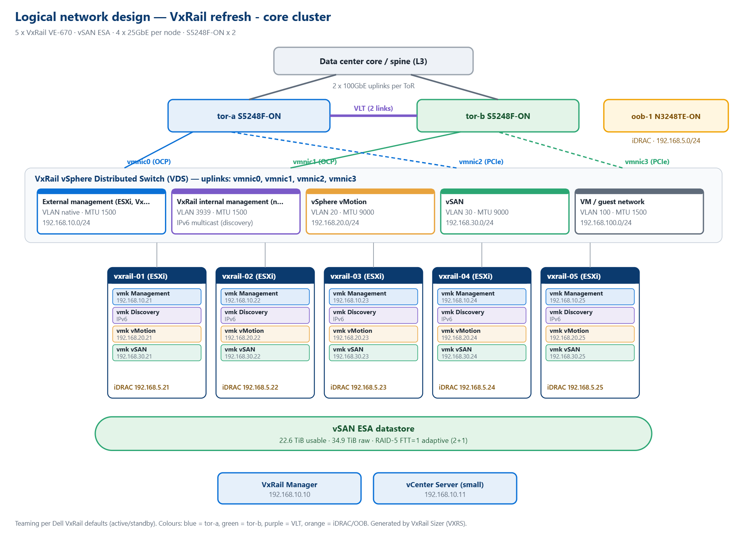
Logical network design
VxRail Sizer (VXRS) · VxRail refresh - core cluster
10

Slide 11
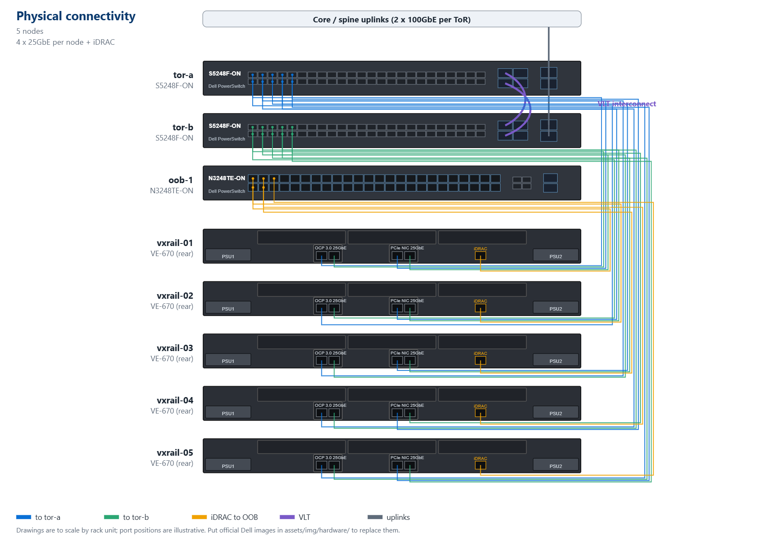
Physical connectivity
VxRail Sizer (VXRS) · VxRail refresh - core cluster
11

Slide 12
Switch configuration rules
Use two or more ToR switches for production (a single switch is acceptable for test/dev and 2-node).
Switch buffer: at least 16 MB per ASIC for 10GbE and 32 MB for 25GbE VxRail networks.
Configure every node-facing port as a trunk carrying all VxRail VLANs; create the internal management VLAN (default 3939) before deployment.
Allow IPv6 multicast on the internal management VLAN for node discovery; enable MLD snooping and querier if supported.
Disable Ethernet flow control on 10GbE and faster ports; use PFC only for RoCE or FCoE.
Set switch-port MTU to match the VDS (9000 when jumbo frames are used for vSAN/vMotion).
IP-hash teaming is not supported. One LAG per cluster (two ports); across two switches requires VLT/MLAG with LACP individual.
Ports cannot be added to VxRail networking after the build; do not mix RJ45 and SFP ports in one VxRail network.
Pair ToR switches with VLT (same model) and connect iDRAC ports to a separate 1GbE out-of-band switch.
Source: Dell VxRail Network Planning Guide (H15300)
VxRail Sizer (VXRS) · VxRail refresh - core cluster
12

Slide 13
Next steps
Validate workload data (RVTools / performance history) and consolidation ratios with the customer.
Confirm the configuration and SKUs with Dell Technologies (VxRail sizing and configurator tools).
Confirm VMware subscription quantities (cores, vSAN add-on TiB) with Broadcom.
Complete the VxRail network pre-deployment checklist (VLANs, 3939 multicast, MTU, DNS/NTP).
VxRail Sizer (VXRS) · VxRail refresh - core cluster
13

Slide 14
Sources (1/3)
Organisation | Document
VMware by Broadcom | VMware vSAN Design Guide (VCF 9.1)
VMware by Broadcom | vSAN Space Efficiency Technologies (VCF 9.1)
VMware by Broadcom | vSAN Stretched Cluster Guide
VMware by Broadcom | vSAN 2-Node Cluster Guide
VMware by Broadcom | Performance Best Practices for vSphere/ESXi/vCenter 9.0
Broadcom TechDocs | Using RAID 5 or RAID 6 Erasure Coding (vSAN 8)
Broadcom TechDocs | About vSAN Policies
Broadcom TechDocs | Planning Capacity in vSAN
Broadcom TechDocs | About Reserved Capacity in vSAN Cluster
Broadcom TechDocs | Designing and Sizing vSAN Hosts (VCF 9.0)
VMware Blogs | Adaptive RAID-5 Erasure Coding with vSAN ESA
VMware Blogs | Auto-RAID in vSAN for VCF 9.1
VMware Blogs | Understanding Reserved Capacity Concepts in vSAN
VMware Blogs | Lower hardware requirements for vSAN (ReadyNode profiles)
VMware Blogs | vCPU to pCPU Ratio Guidelines
VMware Blogs | vSAN Networking - Teaming for Performance
Broadcom Knowledge Base | KB 326889 - vSAN capacity utilisation / operations reserve
Broadcom Knowledge Base | KB 372311 - When 10Gb is used for the vSAN ESA network
Broadcom TechDocs | vSphere HA Cluster Resources Percentage Admission Control
Broadcom TechDocs | vCenter Server Appliance Hardware Requirements
VxRail Sizer (VXRS) · VxRail refresh - core cluster
14

Slide 15
Sources (2/3)
Organisation | Document
Dell Technologies | Dell KB 000223349 - VxRail Manager VM resources
Broadcom TechDocs | Deploying a vSAN Witness Appliance (VCF 9.0)
Broadcom Knowledge Base | KB 313548 - Counting cores for VCF and VVF, vSAN capacity
Broadcom | VMware Cloud Foundation Specific Program Documentation (Feb 2026)
Broadcom | VMware vSphere Foundation Specific Program Documentation (Feb 2026)
Dell Technologies | Dell KB 000310965 - VxRail licensing when upgrading 8.0 to 9.0
Dell Technologies | Dell VxRail Spec Sheet (H16763)
Dell Technologies | Dell VxRail HCI (dell.com)
Dell Technologies | Dell KB 000023374 - VxRail models to PowerEdge models
Dell Technologies | VxRail VE-660 Hardware Requirements and Specifications
Dell Technologies | VxRail VP-760 / VS-760 Hardware Requirements and Specifications
Dell Technologies | VxRail VE-6615 Hardware Requirements and Specifications
Dell Technologies | VxRail VP-7625 Hardware Requirements and Specifications
Dell Technologies | VxRail VD-4000r Configurations and Features
Dell Technologies | Dell VxRail Network Planning Guide (H15300.37, June 2026)
Dell Technologies | Network Planning Guide - VLAN considerations
Dell Technologies | Network Planning Guide - VxRail networking port options
Dell Technologies | Network Planning Guide - Switch considerations
Dell Technologies | Network Planning Guide - Teaming and failover policies
Dell Technologies | Network Planning Guide - Data center network MTU
VxRail Sizer (VXRS) · VxRail refresh - core cluster
15

Slide 16
Sources (3/3)
Organisation | Document
Dell Technologies | Network Planning Guide - Node discovery and the Ethernet switch
Dell Technologies | Network Planning Guide - 2-node cluster
Dell Technologies | Network Planning Guide - Flow control
Dell Technologies | VxRail Architecture Overview - vSAN ESA
Dell Technologies | VxRail 8.0.x Administration Guide - Expand a cluster
Dell Technologies | Dell KB 000203918 - Witness networking requirements
Dell Technologies | Dell PowerSwitch S5200-ON Series Spec Sheet
Dell Technologies | Dell PowerSwitch S5448F-ON Spec Sheet
Dell Technologies | Dell PowerSwitch S4100-ON Series Spec Sheet
Dell Technologies | Dell PowerSwitch Z9432F-ON Spec Sheet
Dell Technologies | Dell PowerSwitch Z9264F-ON Installation Guide
Dell Technologies | Dell PowerSwitch N3200-ON Series Spec Sheet
Dell Technologies | Dell PowerSwitch S3248T-ON Spec Sheet
VxRail Sizer (VXRS) · VxRail refresh - core cluster
16

