Slide 1
NIYAASOFT
WAF sizing and design
Public portal WAF refresh
Niyyasoft - Riyadh DC
Prepared by Niyyasoft - 20 September 2026

Slide 2
The recommendation
NetScaler MPX 8930 (Premium) x2 in reverse proxy (full proxy), sized for 89K/s and 17.9 Gbps with 8K/s new TLS handshakes/sec, running at about 74% of rating.
NetScaler MPX 8930 (Premium)
2 x units
74%
89K/s
Citrix NetScaler - 1U Rack
Active / standby pair
Load at end of term, limited by throughput
Required per unit, with 17.9 Gbps and 8K/s TLS
One box does load balancing, GSLB, TLS offload, caching, compression, bot management and the WAF, with a single licence edition covering the lot. Pooled capacity means throughput can be moved between appliances and form factors as the estate changes, which no other vendor here matches as cleanly.
Worth knowing: The WAF needs Premium edition. Standard and Advanced licences will not run AppFirewall, so an upgrade to Premium is part of the sizing answer whenever an existing Standard or Advanced estate is being extended. VPX throughput is licensed, not physical - a VPX 3000 will not pass more than 3 Gbps whatever the host can do.
The Web App Firewall needs NetScaler Premium edition. A Standard or Advanced licence cannot run AppFirewall at any platform size, so an existing estate on those editions needs an edition upgrade as well as capacity.
Generated by Niyaasoft WAF Sizing Tool | Niyyasoft | 20 September 2026
2

Slide 3
Requirements
The inputs the sizing was built from
Requirement | Value
Customer | Niyyasoft
Site / environment | Riyadh DC
Application profile | E-commerce / public website
Protected applications | 5 across 1 site
Where the WAF sits | Internet edge / public web apps
Insertion mode | Reverse proxy (full proxy)
Measured peak request rate | 24K/s
Measured peak throughput | 3.2 Gbps
Concurrent users | 45,000
Average transaction size | 25 KB
Requirement | Value
Encrypted traffic | 100% over TLS, RSA 2048 keys
Requests per TLS connection | 8
Re-encrypt to back end | No - clear text to the server pool
Security capabilities | Bot management and scraping defence; Application-layer (L7) DoS protection
High availability | Active / standby pair (2 units)
Growth allowance | 20% a year for 3 years
Design headroom | 35% spare at end of term
Form factor | Any (no preference)
Compliance driver | Not specified
Generated by Niyaasoft WAF Sizing Tool | Niyyasoft | 20 September 2026
3

Slide 4
How the size was calculated
Each step applied in order, so the design can be defended
Step | Result
Day-one request rate | 24K/s
Day-one application throughput | 4.8 Gbps
New TLS handshakes per second | 3K/s (RSA 2048)
Inspection cost factor | x1.40
Insertion mode factor | x1.00
Growth to end of term | x1.73
Design headroom | 35% spare (divide by 0.65)
Load carried by each unit | 100% of total, across 2 units
Concurrent connections | 479K
Required per-unit rating | 89K/s / 17.9 Gbps / 8K/s TLS
What the vendor sizes on
NetScaler sizes on system throughput, HTTP requests per second, SSL bulk throughput and SSL transactions per second at RSA-2048 or ECDSA P-256. AppFirewall runs in the packet-processing path, so the figure that matters is throughput and request rate with the firewall profile applied - typically a third of the system rating once signatures, learning and bot protection are on.
Why a WAF is not sized like a firewall
A firewall is sized on throughput. A WAF is sized on requests per second and TLS handshakes per second, because it parses every request and response rather than forwarding packets. The headline throughput on a datasheet is reached with no policy at all.
Generated by Niyaasoft WAF Sizing Tool | Niyyasoft | 20 September 2026
4

Slide 5
The platform
NetScaler MPX 8930 (Premium) - 1U Rack
Attribute | Specification
Vendor | Citrix NetScaler - NetScaler Web App Firewall (AppFirewall) - Premium edition
Model | NetScaler MPX 8930 (Premium)
Product family | MPX 8900
Form factor | 1U Rack (x2)
WAF request rate | 420K/s
WAF throughput | 24 Gbps
L7 throughput without WAF | 55 Gbps
TLS handshakes/sec | 28K/s RSA 2048, 72K/s ECDSA P-256 (sized on RSA)
Bulk TLS throughput | 26 Gbps
Attribute | Specification
Concurrent connections | 24M
Rated applications | 80
Interfaces | 8x 10GbE SFP+, 4x 25GbE SFP28
High availability | Active/Passive, Cluster
Operating system | NetScaler (Citrix ADC) firmware
Management | NetScaler Console (formerly Citrix ADM), on-premises or cloud
Positioning | Top of the MPX 8900 range.
Generated by Niyaasoft WAF Sizing Tool | Niyyasoft | 20 September 2026
5

Slide 6
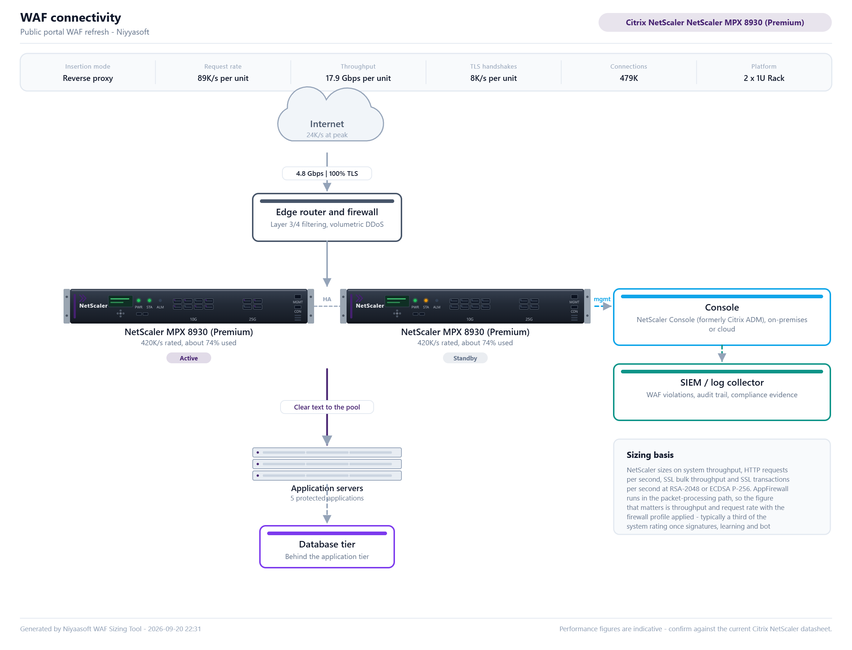
Connectivity design
How the WAF is inserted into the traffic path
Generated by Niyaasoft WAF Sizing Tool | Niyyasoft | 20 September 2026
6

Slide 7
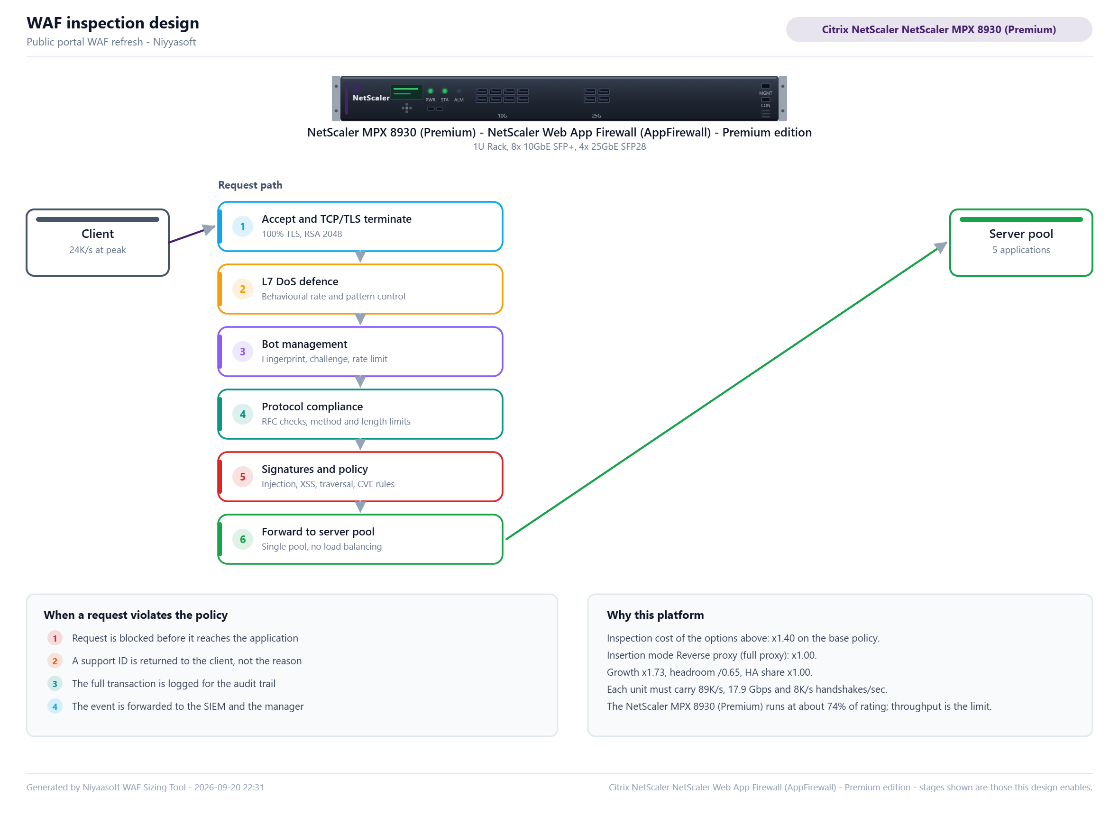
Inspection design
What the WAF does to a request, stage by stage
Generated by Niyaasoft WAF Sizing Tool | Niyyasoft | 20 September 2026
7

Slide 8
Inspection design
The stages this design enables, in the order they run
# | Stage | What it does
1 | Accept and TCP/TLS terminate | 100% TLS, RSA 2048
2 | L7 DoS defence | Behavioural rate and pattern control
3 | Bot management | Fingerprint, challenge, rate limit
4 | Protocol compliance | RFC checks, method and length limits
5 | Signatures and policy | Injection, XSS, traversal, CVE rules
6 | Forward to server pool | Single pool, no load balancing
When a request is blocked
Blocked before it reaches the application. A support ID, not the reason, is returned to the client. The full transaction is logged for the audit trail and forwarded to the SIEM.
Inspection cost
These options multiply the platform requirement by 1.40.
Generated by Niyaasoft WAF Sizing Tool | Niyyasoft | 20 September 2026
8

Slide 9
Licensing and bill of materials
Every line is here because of something in the requirements
Item | Type | Qty | Why it is on the list
NetScaler MPX 8930 (Premium) | Platform | 2 | Active / standby pair, each unit sized for 100% of the load.
NetScaler Premium edition | Module | 2 | Mandatory on every deployment of this platform.
Platform licence (MPX / SDX / VPX / BLX / CPX) | Module | 2 | Mandatory on every deployment of this platform.
Bot Management | Module | 2 | Asked for: Bot management and scraping defence.
WAF signature and security updates | Subscription | 1 | Required to keep the negative security model current.
NetScaler support (Select / Premier) | Support | 2 | Mandatory on every deployment of this platform.
Generated by Niyaasoft WAF Sizing Tool | Niyyasoft | 20 September 2026
9

Slide 10
How the three vendors compare
The same requirement, measured against each range
Vendor | Smallest model that fits | Form | Requests/s | Throughput | TLS/s | Fit | Load | Limited by
F5 | No qualifying model | - | - | - | - | - | - | -
Imperva | No qualifying model | - | - | - | - | - | - | -
Citrix NetScaler * | NetScaler MPX 8930 (Premium) | 1U Rack | 420K/s | 24 Gbps | 28K/s | 100% | 74% | throughput
* the vendor this deck is written for. The smallest qualifying model is shown for each range, so the comparison is like for like rather than a comparison of flagship platforms.
Fit is the weakest dimension against the requirement, never an average - 100% means every dimension is met, and Load then says how much of that capacity the design uses.
Figures are indicative and held for relative sizing. The final model must be confirmed against the current vendor datasheet before a quotation is issued.
Generated by Niyaasoft WAF Sizing Tool | Niyyasoft | 20 September 2026
10

Slide 11
Assumptions and next steps
What this design rests on, and what to do about it
Assumptions
Performance figures in this document are indicative values held for relative sizing between models. Each vendor publishes against a different test profile and revises the numbers per software release, so the final model must be confirmed against the current Citrix NetScaler datasheet before a quotation is issued.
The sizing is driven by layer-7 request rate, application throughput, new TLS handshake rate and concurrent connections. A WAF is not sized on the headline throughput of the platform: with a production policy enabled the usable rate is a fraction of it.
Growth of 20% a year has been compounded over 3 years, and the platform is sized to run at no more than 65% of its rating at the end of that term.
Each unit in the high-availability group is sized to carry 100% of the total load, so the loss of one unit does not degrade the service. Sizing a pair at half the load each is the most common WAF sizing error and is deliberately not done here.
TLS handshake capacity has been sized on RSA-2048 certificates. Moving to ECDSA P-256 would roughly double the available handshake rate on the same platform, which is often cheaper than moving up a model.
Next steps
1. Confirm the request rate and TLS handshake rate from the existing load balancer or web server logs, at the busy hour rather than the daily average.
2. Validate the chosen model against the current Citrix NetScaler datasheet, and ask the vendor to confirm the figures for the policy in this design.
3. Agree the insertion mode with the network team, and whether a learning period in monitoring mode comes first.
4. Price the bill of materials with the term and support tier the customer actually wants.
5. Plan the policy build: a WAF in blocking mode with an untuned policy breaks applications, so budget the tuning effort.
Generated by Niyaasoft WAF Sizing Tool | Niyyasoft | 20 September 2026
11

