Slide 1

Floor Plan Measurement - wireless survey
Contoso Ltd | Floor Plan Measurement - office floor | 2026-09-21
Niyyasoft | Niyya Software

Slide 2
Design summary
22 access points across 2 floor plan(s)
2,097 m2 surveyed, one AP per 95.3 m2
Primary target -67 dBm, secondary -72 dBm
PoE load 841.5 W over 22 access ports
Switch capacity 48 ports / 437 W budget

Slide 3
Coverage against target
Floor | Band | >= primary | >= secondary | Mean RSSI
Level 1 general arrangement | 5 GHz | 97.5 % | 97.6 % | -45.7 dBm
Floor Plan Measurement | 5 GHz | 100 % | 100 % | -43.7 dBm

Slide 4
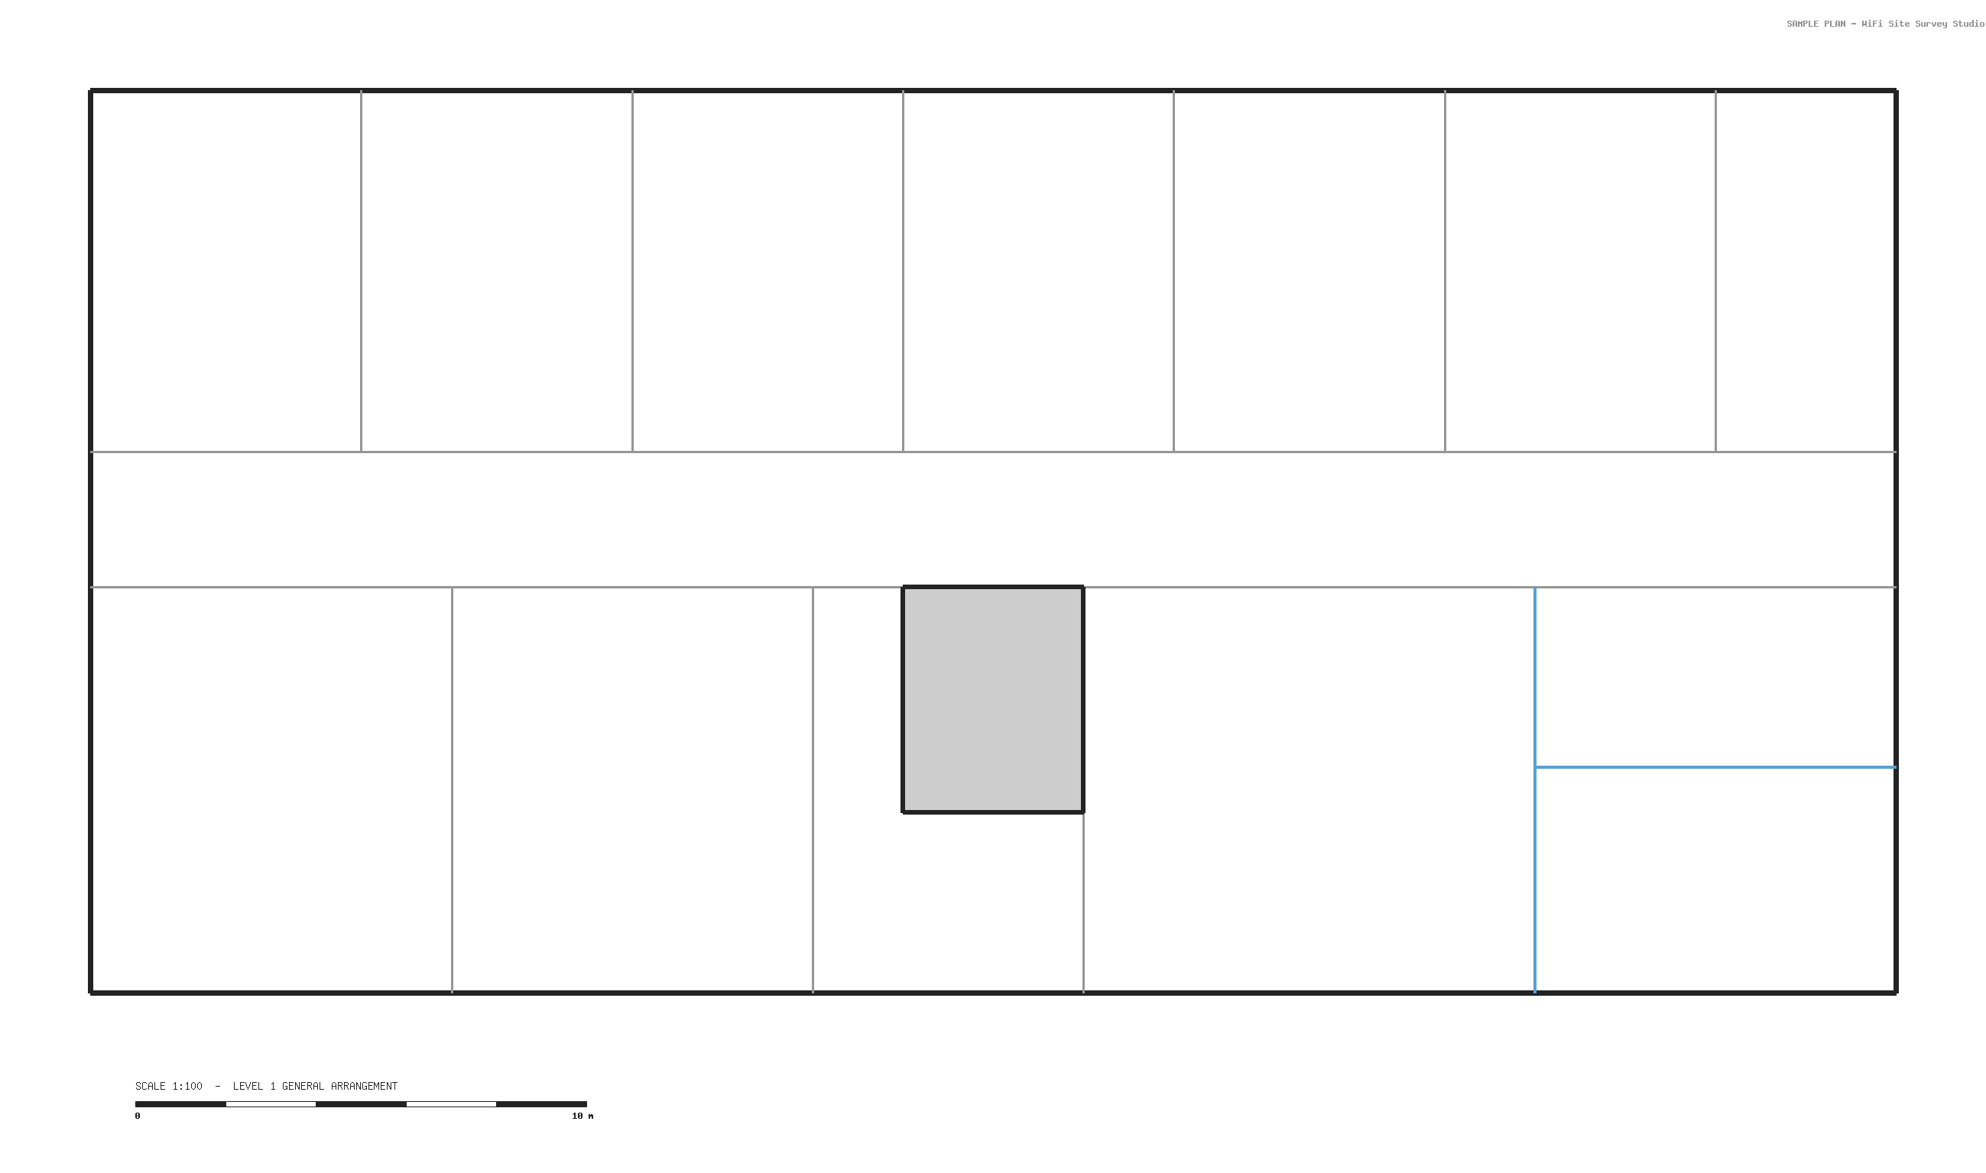
Heat map - Level 1 general arrangement
predictive coverage

Slide 5
Heat map - Floor Plan Measurement
predictive coverage

Slide 6
Bill of materials
Vendor | SKU | Category | Qty
Cisco | C9120AXI | Access point | 11
Cisco | C9300-48P | Access switch | 1
Cisco | C9800-L-C-K9 | Controller / gateway | 1
Cisco | CW9166I | Access point | 11

Slide 7
Physical connectivity
AP - access switch - controller / gateway

Slide 8
Logical design
SSID - VLAN - services

Slide 9
Findings
Ref | Location | Category | Severity | Observation
F-01 | Service core | Coverage | Medium | The concrete core sits in the middle of the floor plate and blocks the direct path between

Slide 10
Recommendations
Adopt the eleven-AP layout

Slide 11
Actions
Ref | Action | Owner | Due | Status
A-01 | Confirm cable routes and containment with the FM team | Contoso | 2026-10-05 | Not started
A-02 | Order the hardware in the bill of materials | Niyyasoft | 2026-10-12 | Not started

Slide 12
Next steps
Confirm the plan scale against a measured on-site dimension
Agree mounting positions and cable routes with the client
Order hardware per the bill of materials, allowing PoE headroom
Run a post-installation validation survey and tune channels and power
Predictive model - validate on site before hand-over.

